Slide 1
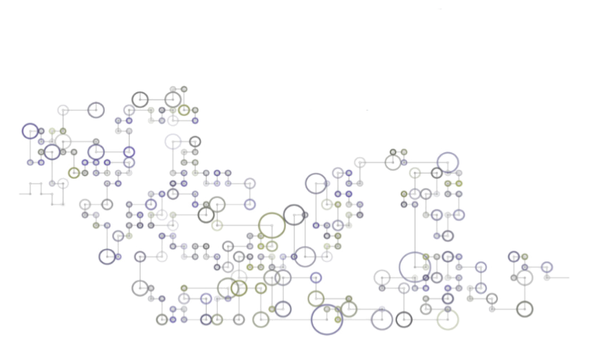
Summer Data Science (Online)
by and for the Liberal Arts
Fully Online, Multi-Campus,
Team-Taught Data Science Class

Slide 2
Liberal Arts Collaborative for Digital Innovation (LACOL)
Amherst College
Bryn Mawr College
Carleton College
Davidson College
Hamilton College
Haverford College
Swarthmore College
Vassar College
Washington and Lee University
Williams College

Slide 3
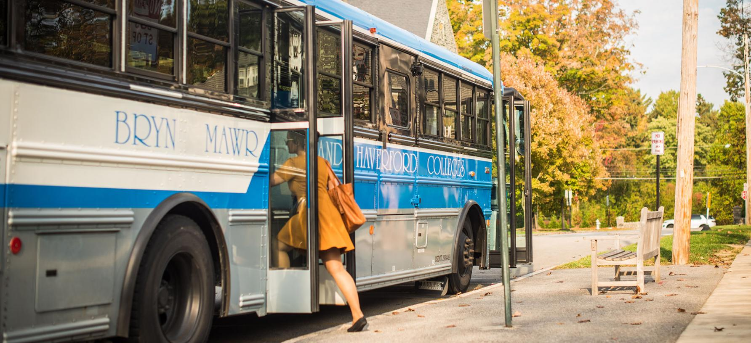
Why do small colleges share courses?

Slide 4
Expand Curricular Opportunities

Slide 5
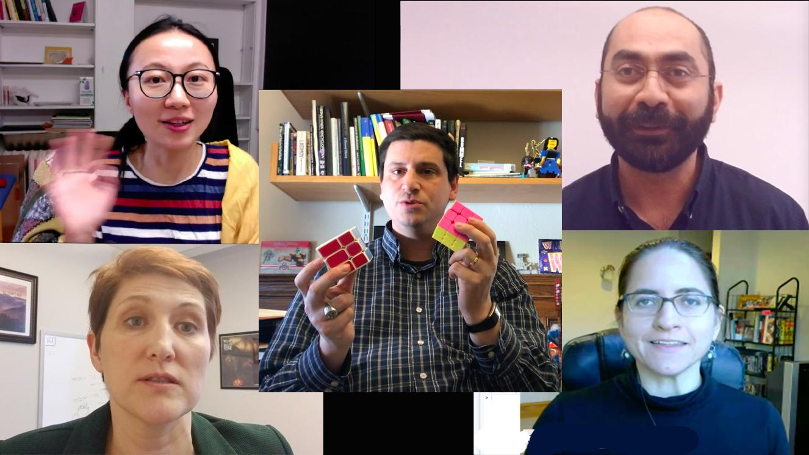
Why would residential colleges share courses online?

Slide 6
Niche courses
Low enrollment courses
Uniquely digital courses
High demand courses
LAC sharing opportunities ...

Slide 7
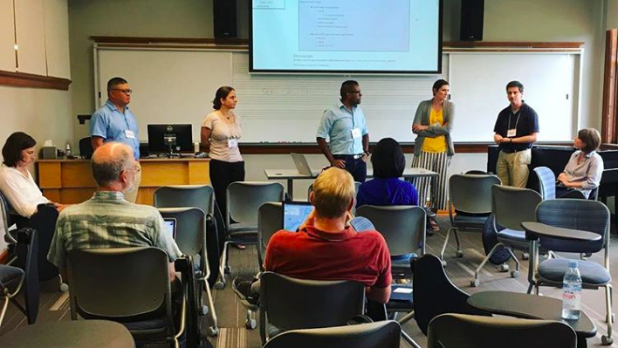
Sharing DATA SCIENCE online for LACOL

Slide 8
Summer 2019 - Data Science Learning Objectives
Data science as a liberal art
Familiarity and expertise in basic coding
Application of basic concepts in statistics
Ability to write and present technical material

Slide 9
Keepin’ it
liberal artsy

Slide 10
Tools & Technology
MoodleCloud
Piazza
Zoom
DataCamp

Slide 11
Students
?
💡

Slide 12
LACOL Summer 2019 Data Science Team
lacol.net/critical-ds
Course Instructors:
Ella Foster-Molina, Swarthmore College
Monika Hu, Vassar College
Moataz Khalifa, Washington and Lee Univ.
Steven J. Miller, Williams College
Natalia Toporikova, Washington and Lee Univ.
Course Designers:
Barron Koralesky, Williams College
Jonathan Leamon, Williams College
Sundi Richard, Davidson College
Jennifer Spohrer, Bryn Mawr College
Student Developers and Teaching Assistants:
Gabriel Duska, Vassar College ‘20
Emma LaPlace, Vassar College ‘20
Arianna Montero-Colbert, Davidson College ‘19
Sudais Moorad, Vassar College ‘20
Kevin Ros, Vassar College ‘20
Bryan Woolley, Williams College ‘21
Kashaf Zaheer, Vassar College ‘22
Key Advisors:
College Registrars
LACOL Shared Course Initiative Steering Cmte
Liz Evans, Haverford College & LACOL
Laurie Heyer, Davidson College
Chad Topaz, Williams College

