Slide 1
Blended Learning, Active Learning, iPads Oh My! Exploring What Blended Learning Looks like For Small Liberal Colleges

Slide 2
Ashley Turner
Academic Technologist
Swarthmore College

Slide 3
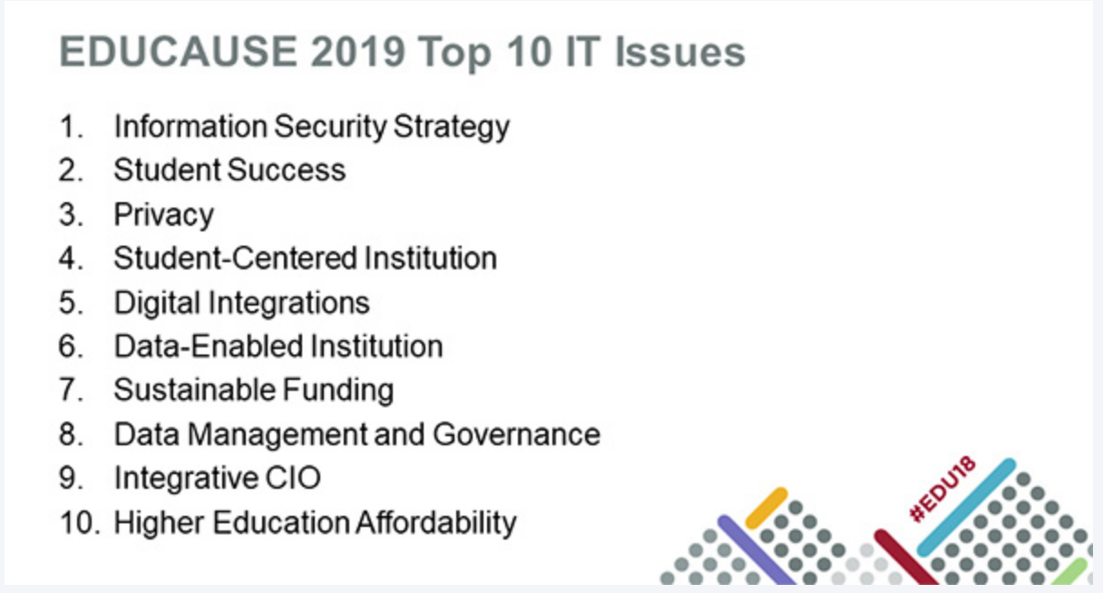
Student Success
Notes:
Student success has made the top 10 IT issues list for the second year in a row and is intertwined with many of the other issues on the list. If you are working on student success initiatives on your campus, you know they can proliferate and grow rapidly with many projects and initiatives popping up at the same time. Moving forward on so many projects simultaneously is a complex undertaking that can dilute efforts and discourage staff involved.
Rightfully so SS has made top 10 list

Slide 4
Why Student Success is Important

Slide 5
Student Success
Notes:
Student success has made the top 10 IT issues list for the second year in a row and is intertwined with many of the other issues on the list. If you are working on student success initiatives on your campus, you know they can proliferate and grow rapidly with many projects and initiatives popping up at the same time. Moving forward on so many projects simultaneously is a complex undertaking that can dilute efforts and discourage staff involved.

Slide 6
Initiative Fatigue
Flipped Instruction/ Blended Learning
Active Learning
Teaching with iPads

Slide 7
3-Part Blended Learning Exploration Series
Define what blended learning is for our campus
Introduce new tools to faculty who have been curious
Learn from other faculty across campus
Provide safe space for faculty to explore possibilities with new tools and ways of thinking
Notes:
Overarching goals

Slide 8
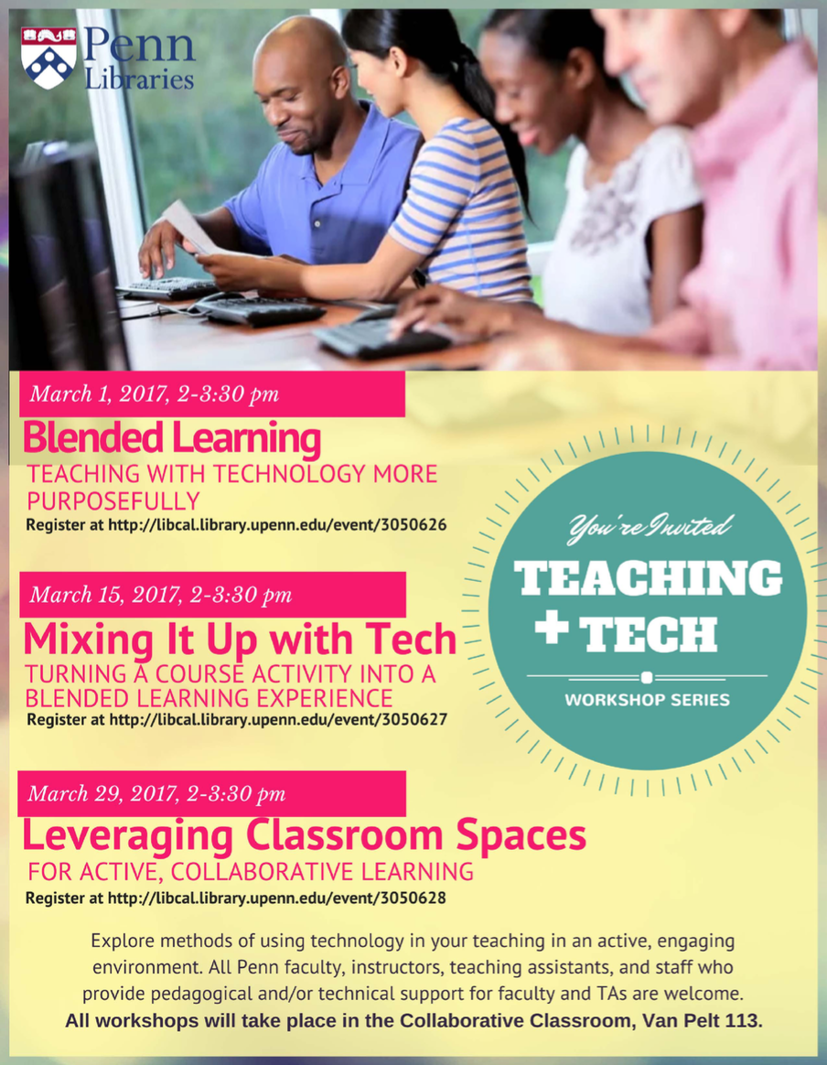
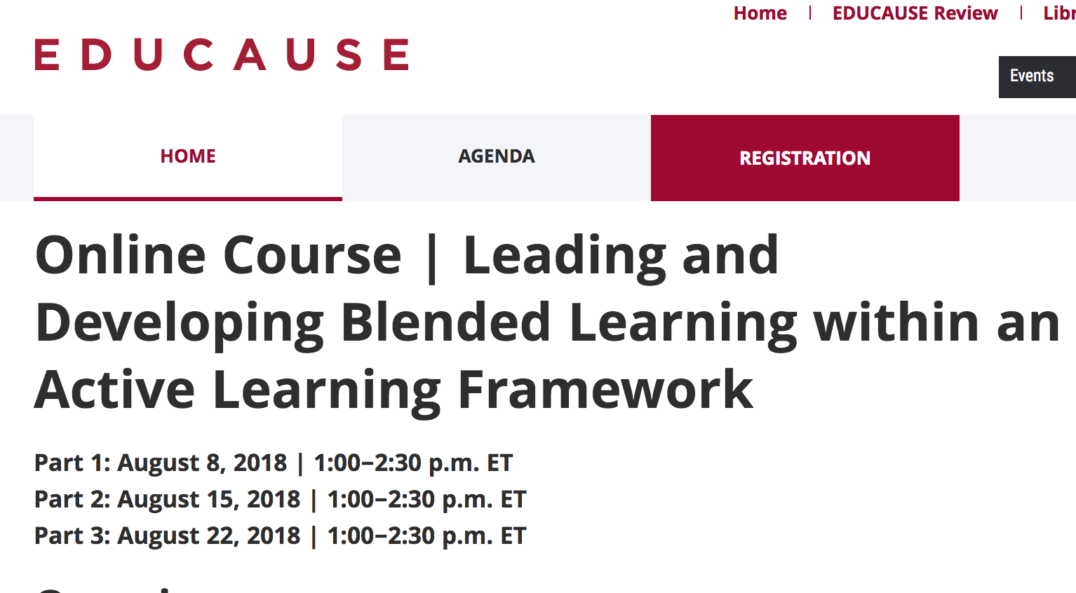
Pulled from other Frameworks
Notes:
Explore the benefits of blended learning and develop your own philosophy of blended learning
Apply active learning principles in your course through content delivery
Investigate active learning and apply technology tools and facilitation strategies in your course

Slide 9
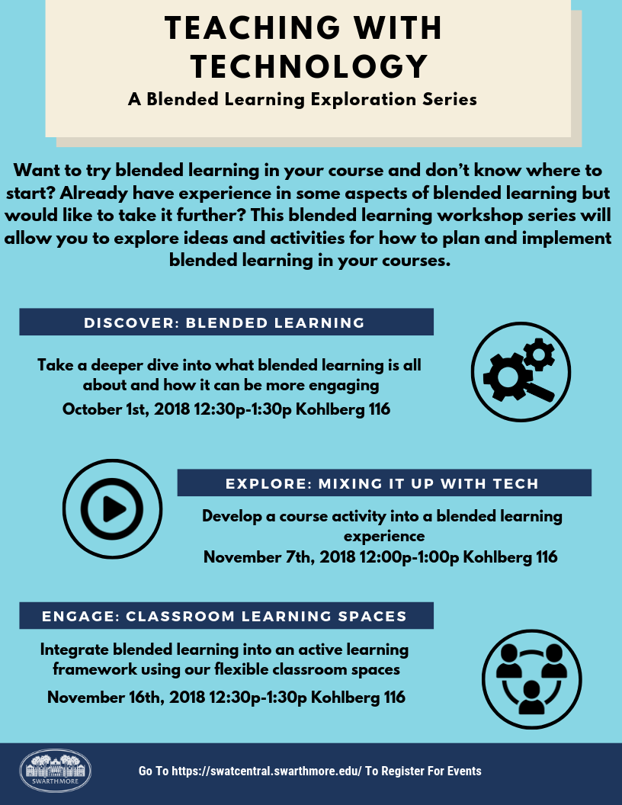

Slide 10
Part 1 Discover:
Fundamentals of Blended Learning
Definition: Blended learning is a combination of online, self-paced learning and face-to-face classroom instruction.
Blended Learning in 4 steps:
Learning objective
Content & Delivery
Activities
Assessment
Notes:
It is important to identify what you want students to be able to do and then incorporate that into your learning objective. This will help determine which digital tool is best for content delivery, course activities, and assessment.

Slide 11
Part 2 Explore:
Using mobile apps and iPads for blended learning
Explain Everything for recording videos
Notability for collaborative annotations during class
Quizlet digital flashcards for language learning

Slide 12
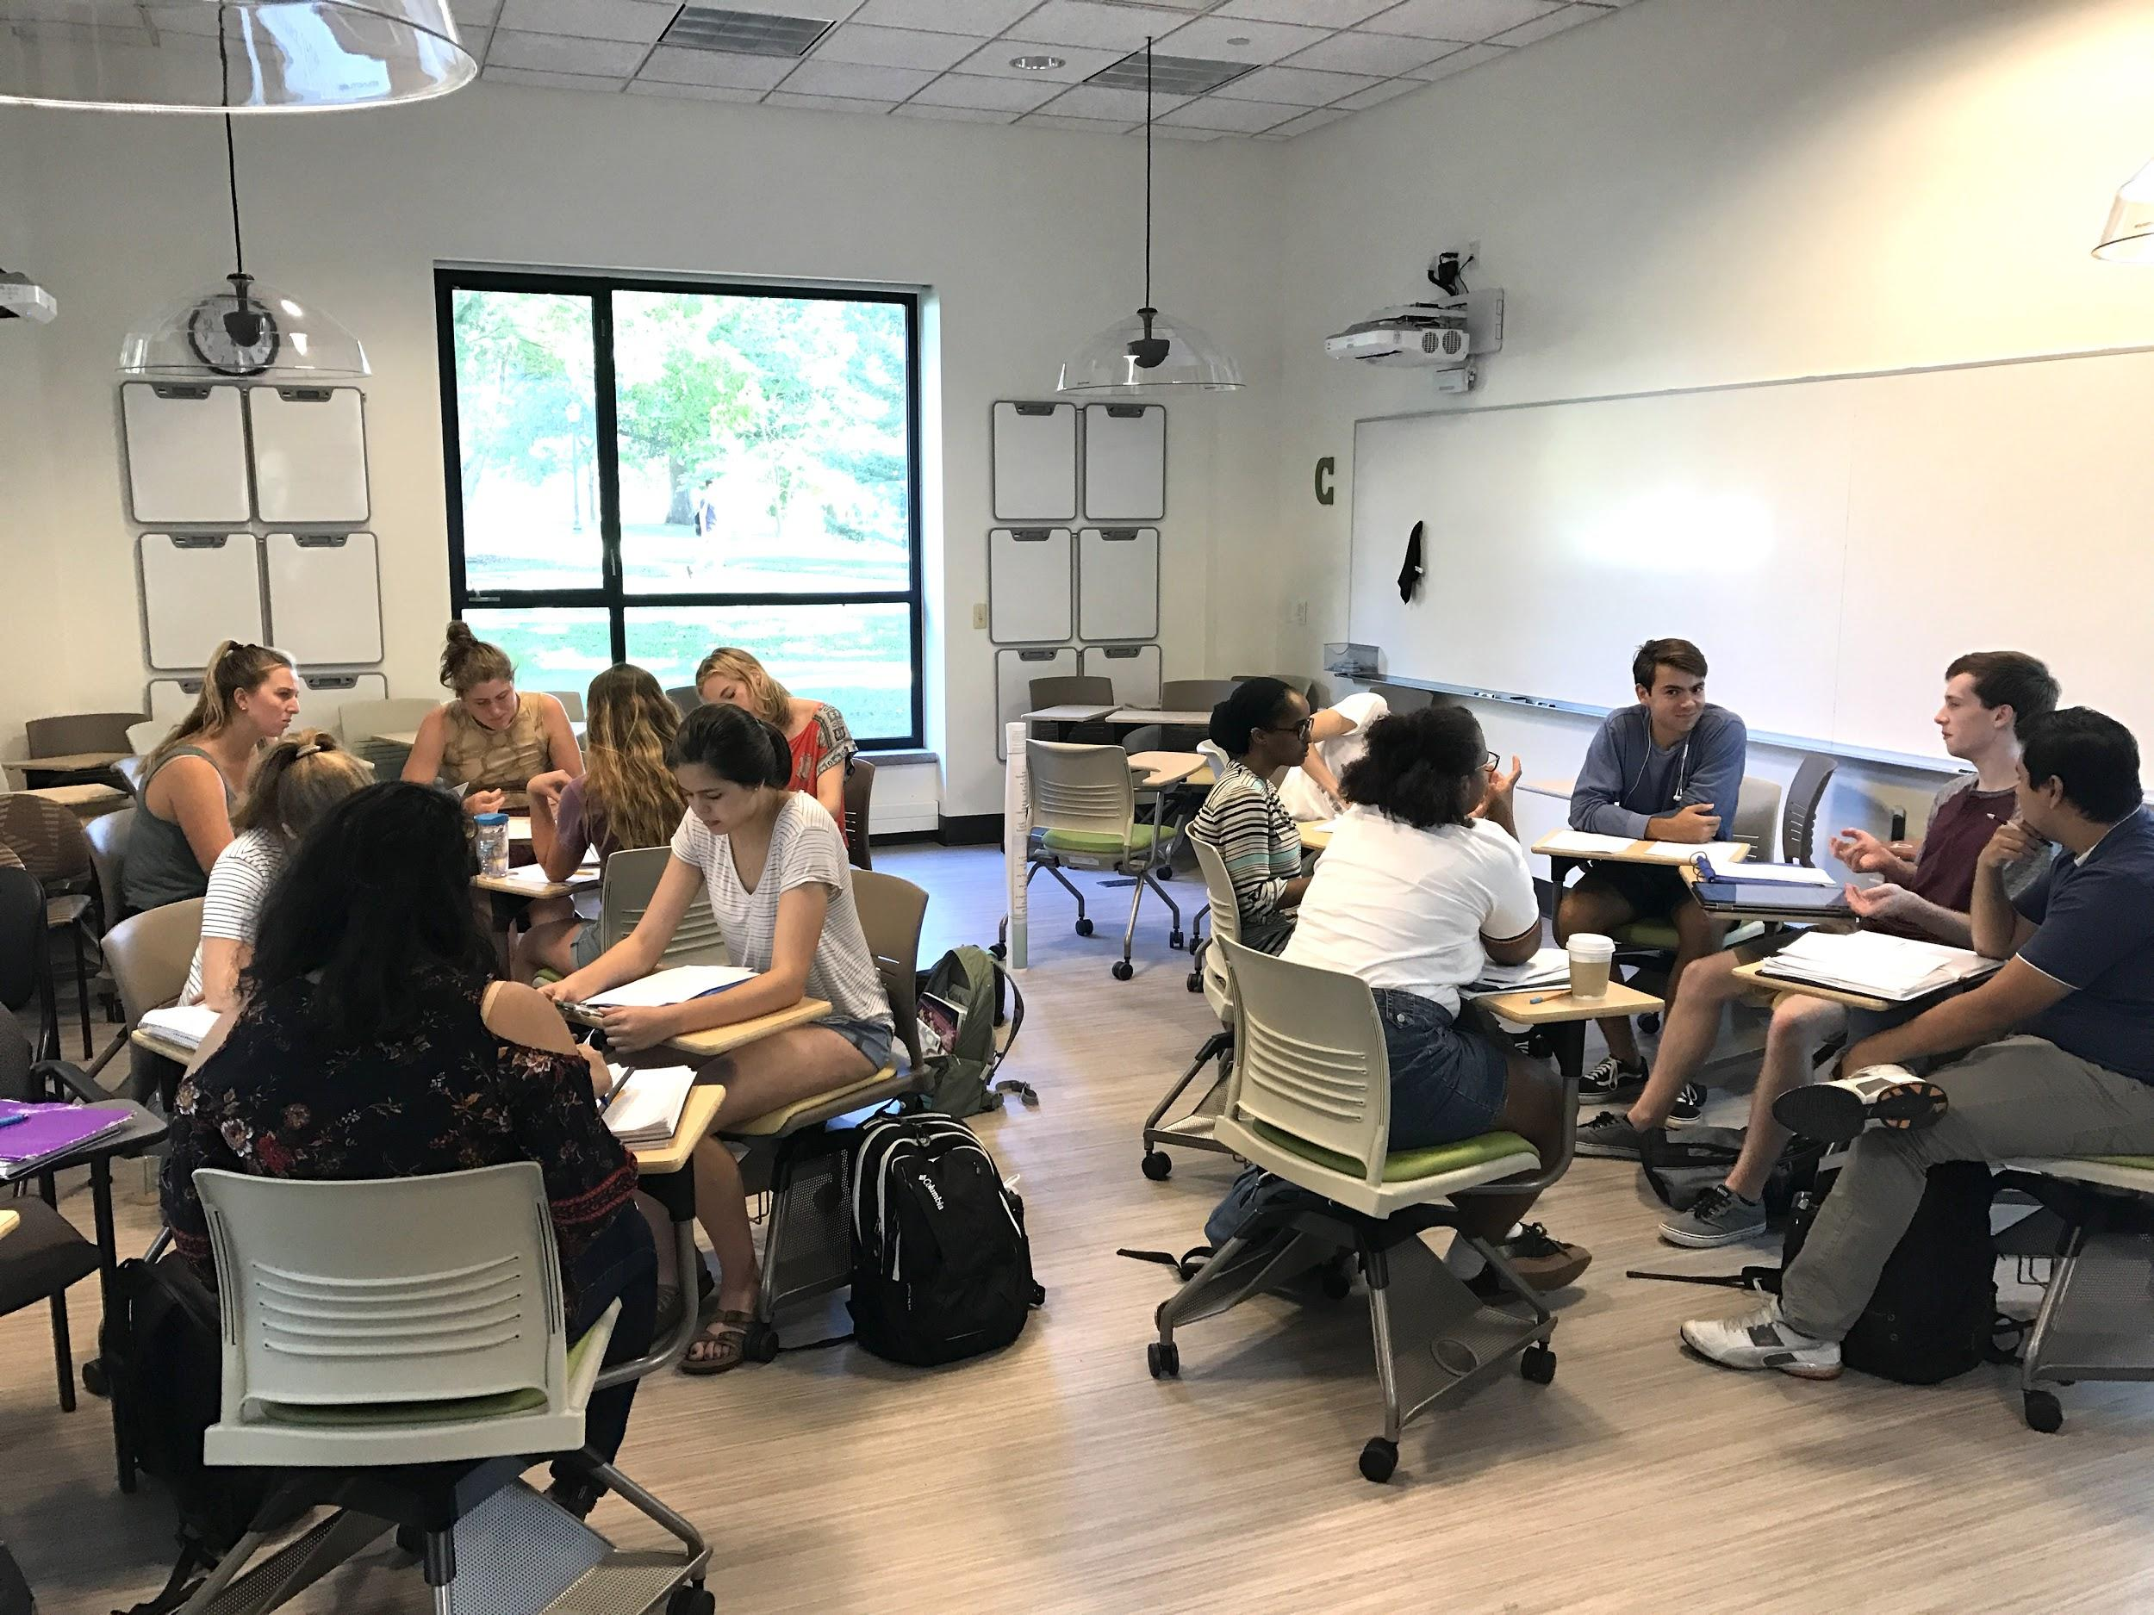
Part 3 Engage:
Utilize active learning classrooms for blended learning
Classroom Technology
Wireless Projection (Apple TV)
Small Huddle Boards
Touch Panel Matrix
Active Learning Techniques

Slide 13
Successes
People left with better understanding of blended learning
Felt more confident in knowing a good amount of what they are already doing is considered blended learning
Through their peers, they learned new features from old tools
More comfortable in exploring with new tools on their own

Slide 14
Opportunities
Get more faculty involved
Many faculty didn’t know what they were doing was blended learning
Start with activity in the beginning or before workshop
One hour is not enough time for project based learning
Survey the faculty beforehand to see what they are already doing in order to tailor workshop more

Slide 15
Next Steps
See if this can be replicated for active learning initiative
Collaborate with faculty more in developing the content
Make it more of a blended experience. Have material available beforehand

