Slide 1
Complementing the Foreign Language Classroom: Two Tools that Develop Oral Production
Joshua M. Pongan
Temple University
2019 Blended Learning in the Liberal Arts Conference
May 23, 2019

Slide 2
The roadmap
The foreign language context
Foreign language teaching over the years
Realities of language learning
Examining two digital tools
Complementing the classroom to enhance oral production

Slide 3
Course context:
Successful language acquisition requires communication-based interaction in the target language
Basic Spanish 1 & II
3 credit hours / week in the classroom
1 credit hour / language lab

Slide 4
Past to present of language teaching and learning: recreating the classroom
Printed workbooks
Taped recordings
Online workbooks
Adaptive-learning digital platforms

Slide 5
Traditional / historical approaches
Strengths
Vocabulary retention
Memorization of grammar rules
Limitations
Lack of genuine oral interaction

Slide 6
Language learning realities in the classroom:
Cognitive load of speaking
Anxiety
Attention paid to speaker
Being able to hear while seated far from the speaker
Notes:
Are t

Slide 7
Online asynchronous interactions
GOAL: Further support introductory-level student language acquisition and enhance the nature, the frequency and flexibility of communicative interactions.
Notes:
The goal is not to reproduce the classroom: It is to extend beyond this.

Slide 8
Two Tools:

Slide 9
voicethread

Slide 10
Extempore
Notes:
Add videos

Slide 11
Addressing the realities and complementing the foreign language classroom

Slide 12
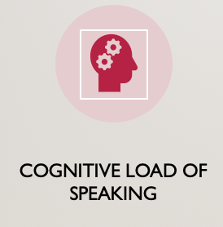
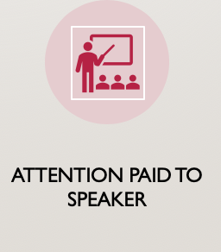
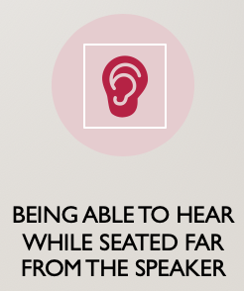
Addressing the realities of the classroom
Controlled reception = More focused oral production
Greater flexibility = Reduced learner anxiety
Required completion = Optimal accountability
Increased student control = Minimized obstacles to comprehension

Slide 13
Complementing the foreign language classroom
Creates a space for practicing and enhancing oral production
Develops oral production skills
Builds speaking confidence
Impact on face-to-face, communicative interactions in the target language

Slide 14
Thank you

