Slide 1
Lightboard videos, Teaching Introductory Chemistry, and Reducing Stereotype Threat
Darlene M. Loprete, Ph.D.
Professor of Chemistry (Biochemistry)
Rhodes College, Memphis TN

Slide 2
Crisis of Representation Participation by Race & Gender
RACE | Percent of STEM Population (S&E) | Percent of US Working Population
White Men | 51 | 70
White Women | 20
Asian Men | 12 | 5
Asian Women | 5
Black Men | 3 | 11
Black Women | 2
Hispanic Men | 4 | 16
Hispanic Women | 2
National Science Foundation Digest (2015). Women, Minorities, and Persons with Disabilities in Science and Engineering

Slide 3
Why Diversify STEM?
Missing talented minds
Important perspectives are absent
We need to….
Secure promising STEM talent/leadership
Encourage and retain more undergraduates of color
and white women in STEM.

Slide 4
Where and Why?
1. WHERE do we lose students of color (SOC)?
2. WHY do we lose SOC?

Slide 5
Where do we Lose Students of Color?
White
Students who intended to major in the natural sciences in their
first year of college
AND do not earn natural sciences degrees;
Asian
Black
National Science Board 2016 https://www.nsf.gov/statistics/2016/nsb20161/#/

Slide 6
Persistence Data from Rhodes and Birmingham-Southern College (BSC)
BSC: 36%
Rhodes: 25%
Percent of students NOT continuing on to the second course in our first-year chemistry sequence.
More alarming is that underrepresented minorities drop out at disproportionately higher rates.

Slide 7
Why do we Lose Students of Color?
Introductory courses an issue
Unwilling to abandon their own cultural identities and assume the cultural identity defined by science
Science is taught without a context
MYTHS Debunked
Science is neutral to race, ethnicity, and gender
Leaving science because they are unable or disinterested
Sheila Tobias. (1990) They’re not Dumb they’re different: A new tier of talent for science. Change 22, 11-30
Seymour, E. and Hewitt, N.M. (1997) Talking about leaving: Why undergraduates leave the sciences. Westview Press
Cabrera, A.F., Colbeck, C.L. and Terenzini, P. T. (2001) Developing performance indicators for assessing classroom
teaching practices and student learning. Res High Educ 42, 327-352

Slide 8
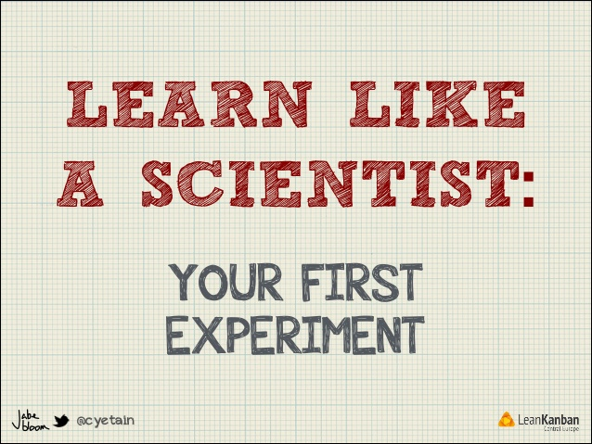
What did we do?
Created and used videos in introductory chemistry classes
-Supplement to the material being taught
GOAL:
1. Provide Counterstereotypical Messaging
2. Hone problem solving skills
3. Change perception about science

Slide 9
Where did we get this idea?
Reduce Negative Stereotype Threat
Jeff Schinske et al – Scientist spotlight homework
Shift from role model to possible selves (anything that makes us “us”) – subtle but important difference
How do they work?
Students review the scientist’s research (journal article, or popular science article)
AND
a resource regarding the scientist’s personal history (they are provided a photo as well).
Good success!
Schinske, J. N., Perkins, H. Snyder, A, and Wyer, M. (2016) CBE Vol. 15 1-18

Slide 10
The Project in More Detail
Showcase diverse scientists
We created 5 lightboard videos (10-12 minutes) devoted to certain topics in introductory chemistry– three major components:
1. Vignette about ourselves (showcase our identities)
- journey and obstacles
- interests outside of science
2. Contextualize the topics
3. Practice problem solving
The videos supplemented class material (not in place of)

Slide 11
What we learned

Slide 12
Perceptions of Scientists
1. Based on what you know now, describe the types of people that do science. If possible, refer to specific scientists and what they tell you about the types of people that do science.
Pre- and post- no real change
curious (33%)
passionate (19%)
smart/intelligent/well educated (18%)
tendency to solve problems through logic or facts (18%)
creativity (2%)

Slide 13
Perceptions of Scientists (con’t )
2. I know of one or more important scientist to whom I can personally relate to (circle one)”:
I don’t know disagree somewhat disagree somewhat agree agree
“agreed” or “strongly agreed”
- 48 % related to a specific teacher or family member who was a scientist
- 28% had shared qualities/background with scientists (curiosity and passion)
“strongly disagreed” or “disagreed”
- 91% did not know a scientist they could relate to

Slide 14
Overall, what we learned and Next Steps
The videos had a positive impact on student motivation and perception
No real impact on students’ views of who does science (curiosity was low and attention here will be important)
91% did not know a scientist they could relate to (need to correlate this with performance and persistence)
Next steps
Prepare more videos (Students at BSC have prepared some already)
Try this experiment again in the fall semester
Write a grant

Slide 15
Collaborators
Rhodes College Birmingham-Southern College
Darlene M. Loprete Kate Hayden
Professor Chemistry Assistant Prof. Chemistry
Dhammi Muesse Scott Dorman
Assistant Prof. Chemistry Professor Chemistry
Thanks to the Associated Colleges of the South and Rhodes for funding.

Slide 16
Resources
Cabrera, A.F., Colbeck, C.L.,and Terenzini, P. T. (2001) Developing performance indicators for assessing classroom
teaching practices and student learning. Res High Educ 42, 327-352
Johnson, A. (2007) Unintended consequences: how science professors discourage women of color. Sci. Educ. 91,
805-821.
National Science Board 2016 https://www.nsf.gov/statistics/2016/nsb20161/#/
National Science Foundation Digest (2015). Women, Minorities, and Persons with Disabilities in Science and Engineering
Tanner, K and Allen, D. (2007) Cultural Competence in the College Biology Classroom. CBE Vol. 6 251-258
Tess L. Killpack and Laverne C. Melón. 2016. Toward Inclusive STEM Classrooms: What Personal Role Do Faculty Play? CBE Life Sci Educ.; 15(3)
Tobias, Sheila. (1990) They’re not Dumb they’re different: A new tier of talent for science. Change 22, 11-30
Schinske, J. N., Perkins, H. Snyder, A, and Wyer, M. (2016) CBE Vol. 15 1-18
Seymour, E. and Hewitt, N.M. (1997) Talking about leaving: Why undergraduates leave the sciences. Westview Press.
Video link: http://www.screencast.com/t/QZ2jn6jb

