Slide 1
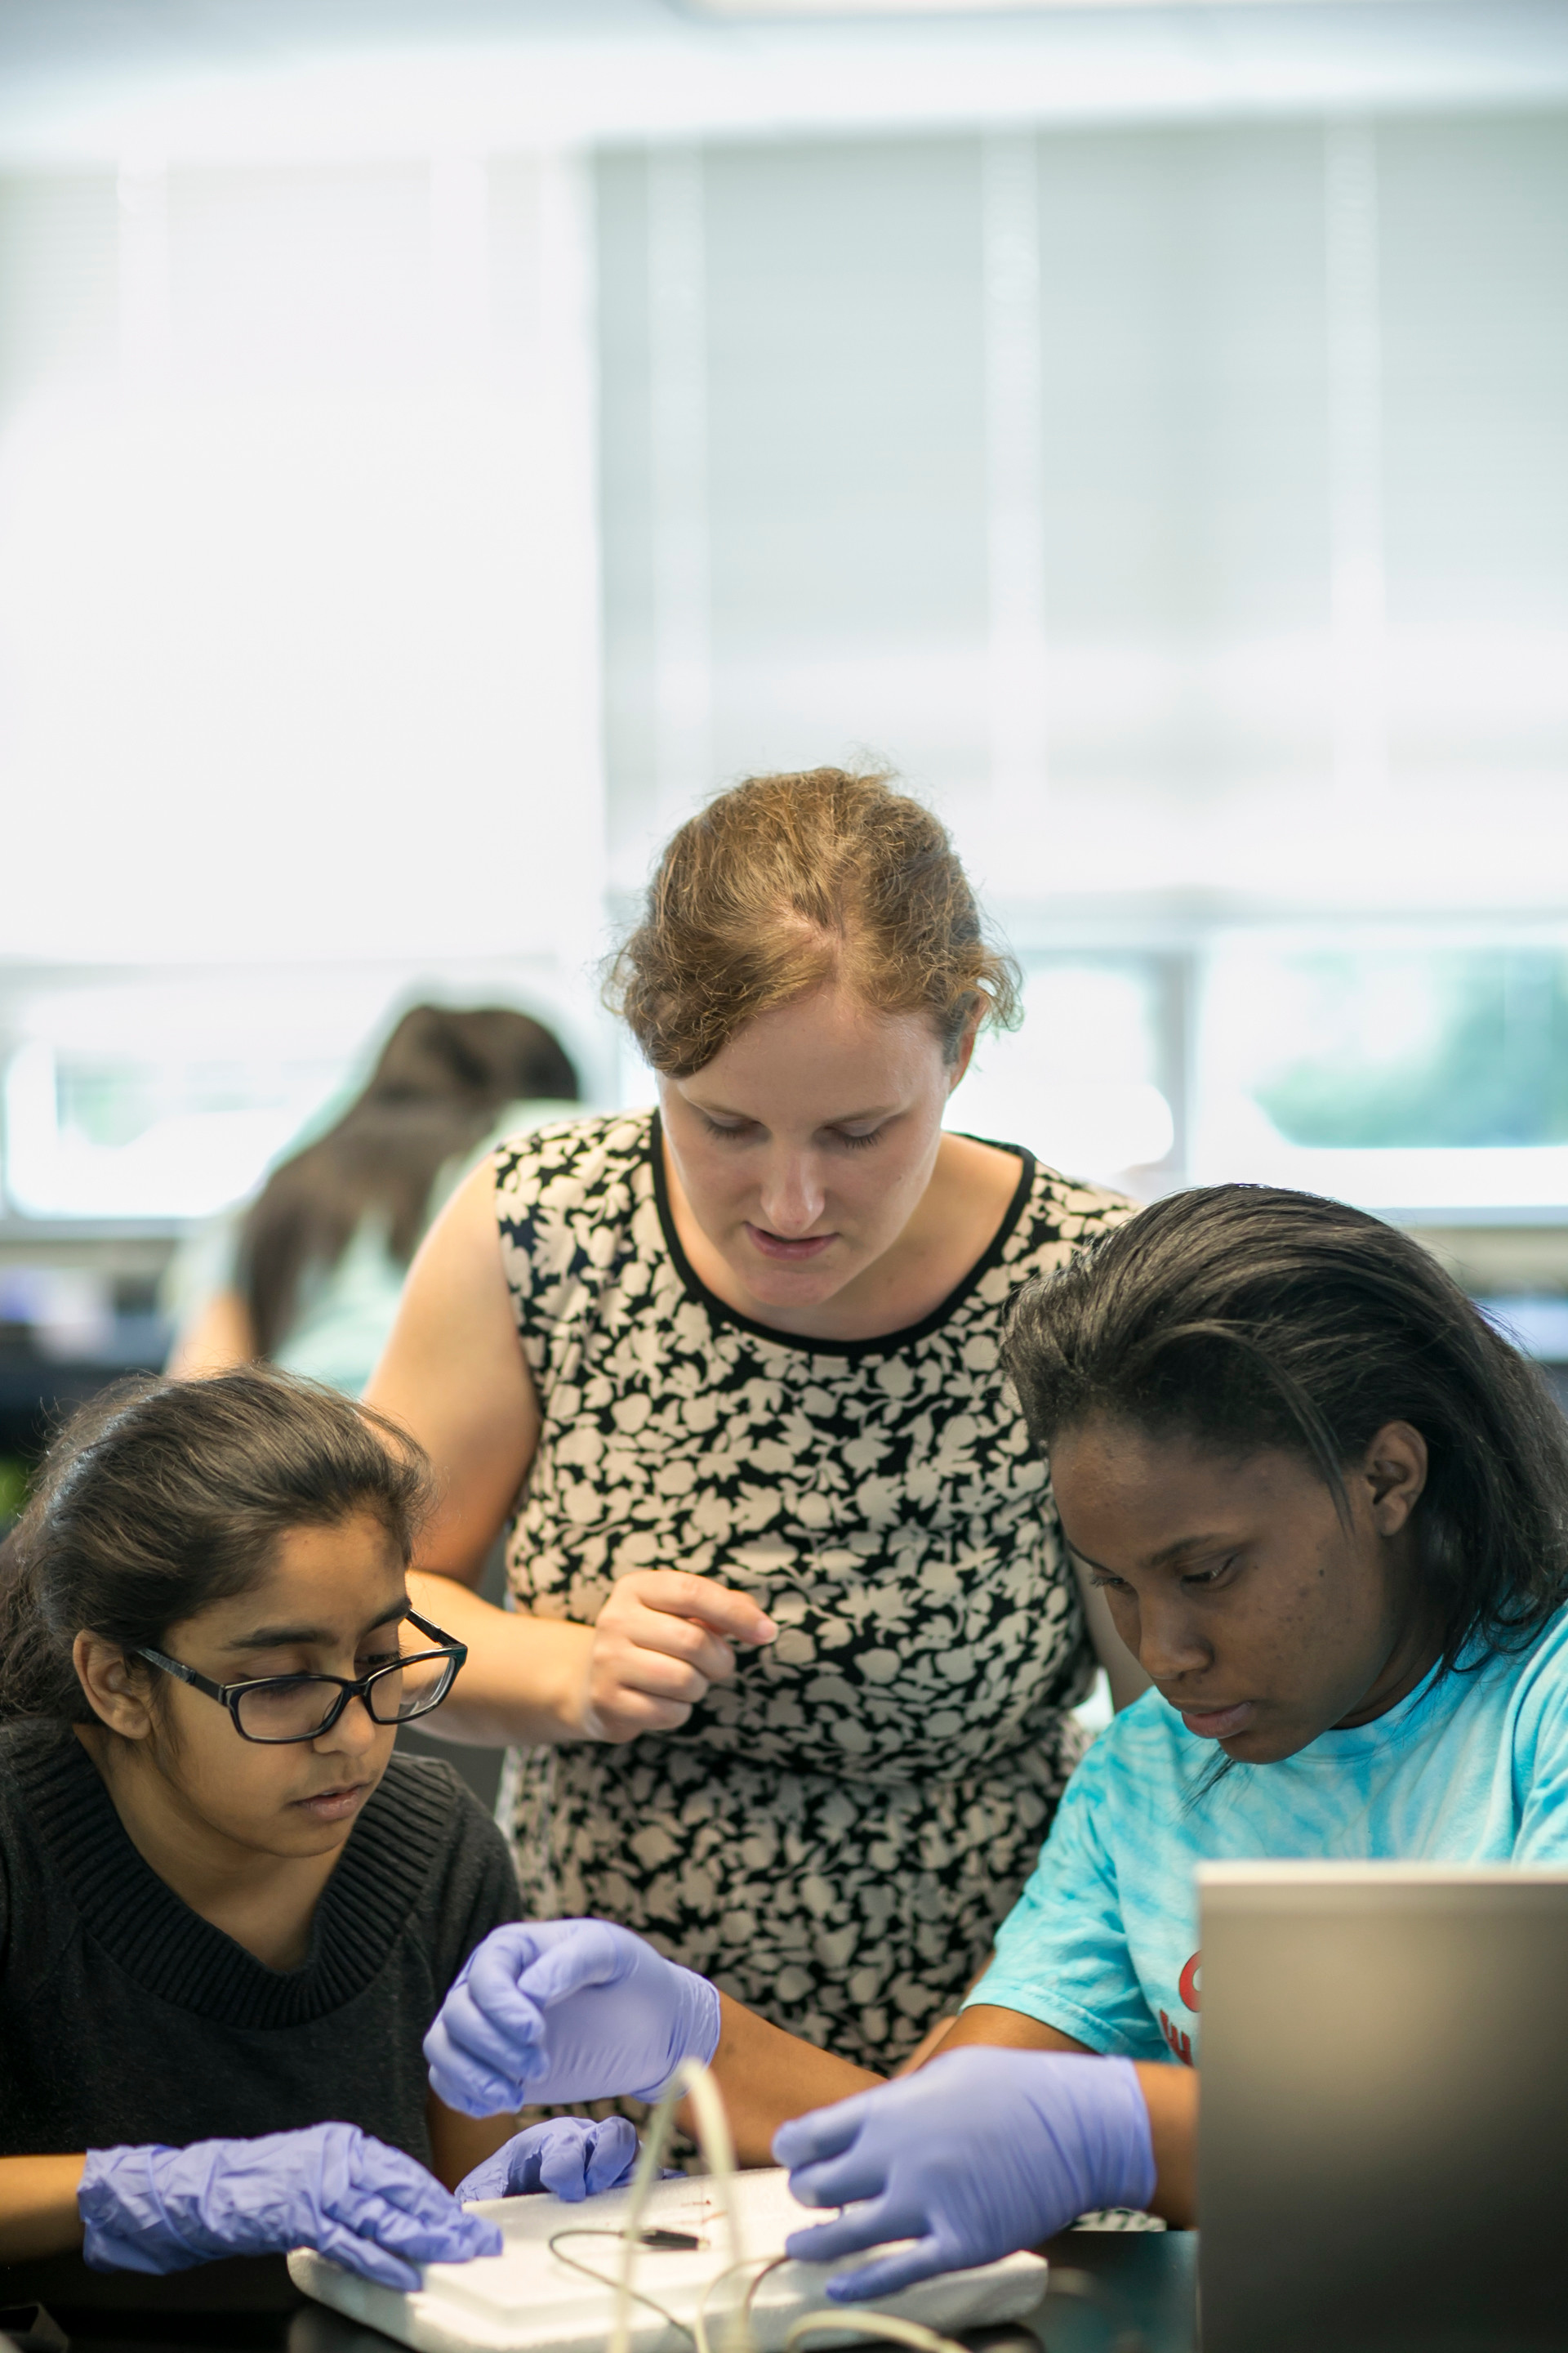
WELCOME!
Blended Learning in the Liberal Arts
Conference 2016
Gina Siesing, Ph.D.
Chief Information Officer &
Constance A. Jones Director of Libraries
gsiesing@brynmawr.edu
@gsiesing

Slide 2
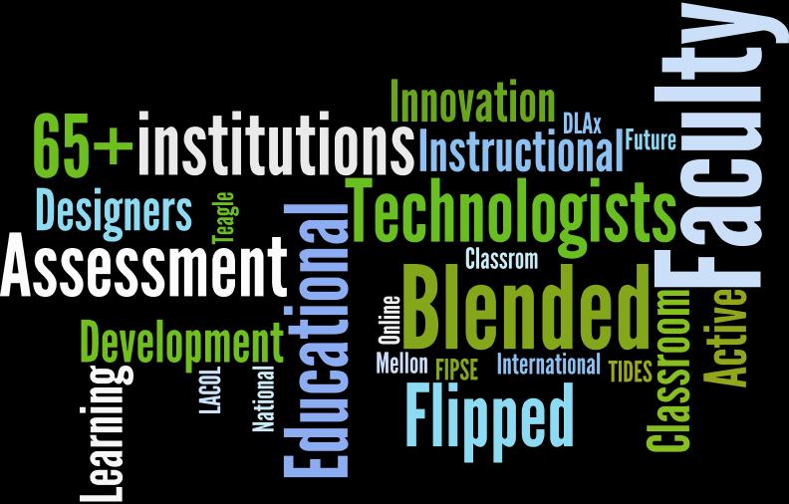
Power of Community
Power of Community
Notes:
Allied Endeavors: Lehigh Valley Consortium, 5 Colleges, TriCo, LACOL, DLAx

Slide 3
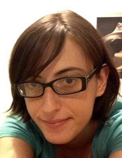
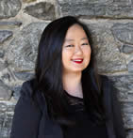
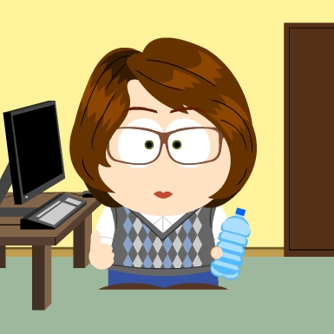
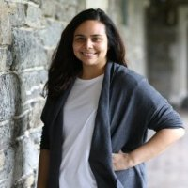
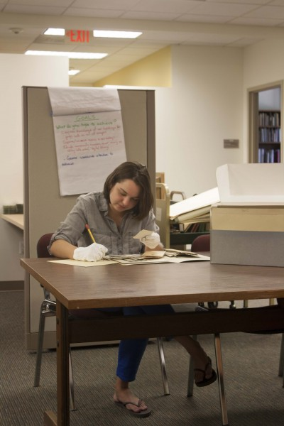
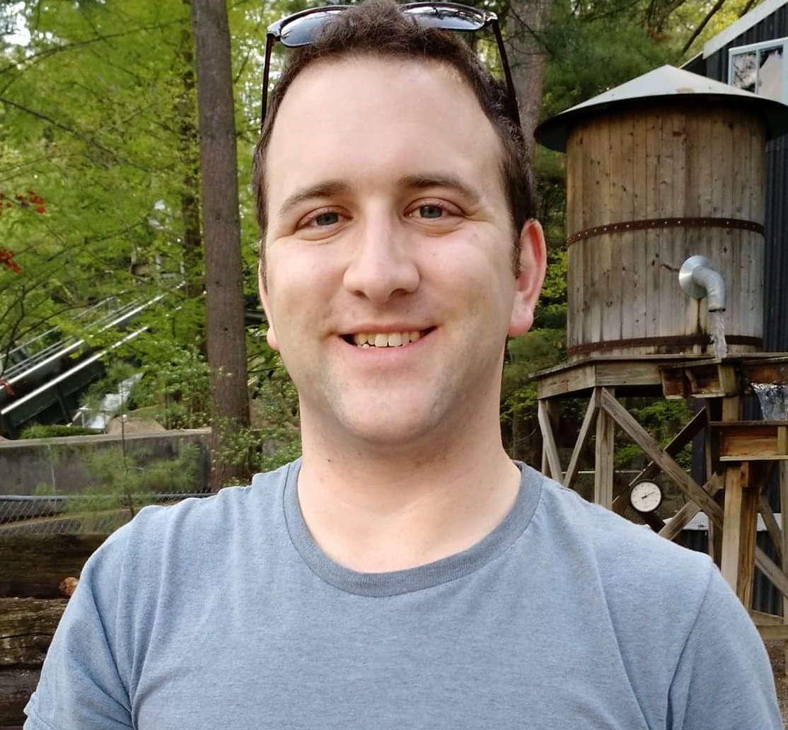
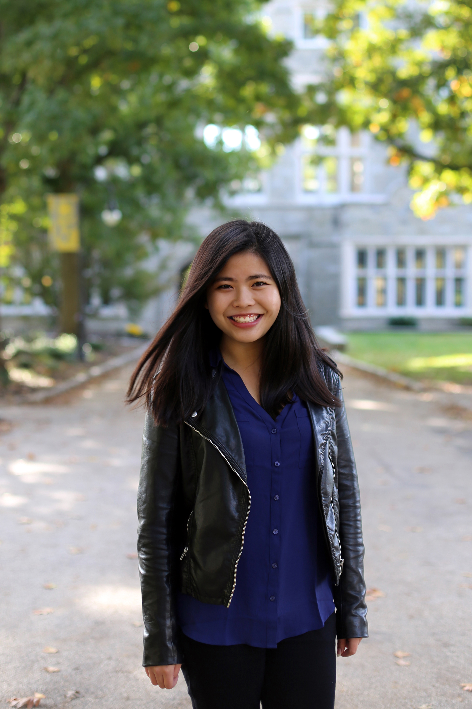
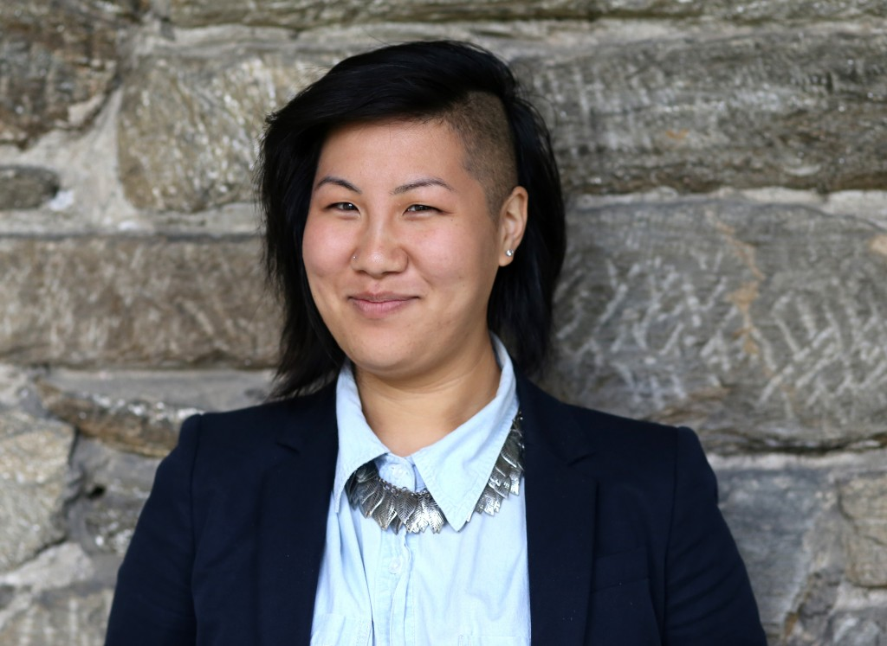
Bringing Us Together
Notes:
Jenny Spohrer
Elizabeth Reilly
Chris Boyland
Helen Chang
Esther Chiang
Jancy Munguia
Beth Seltzer
Sam Palumbo
Jennifer Orr

Slide 4
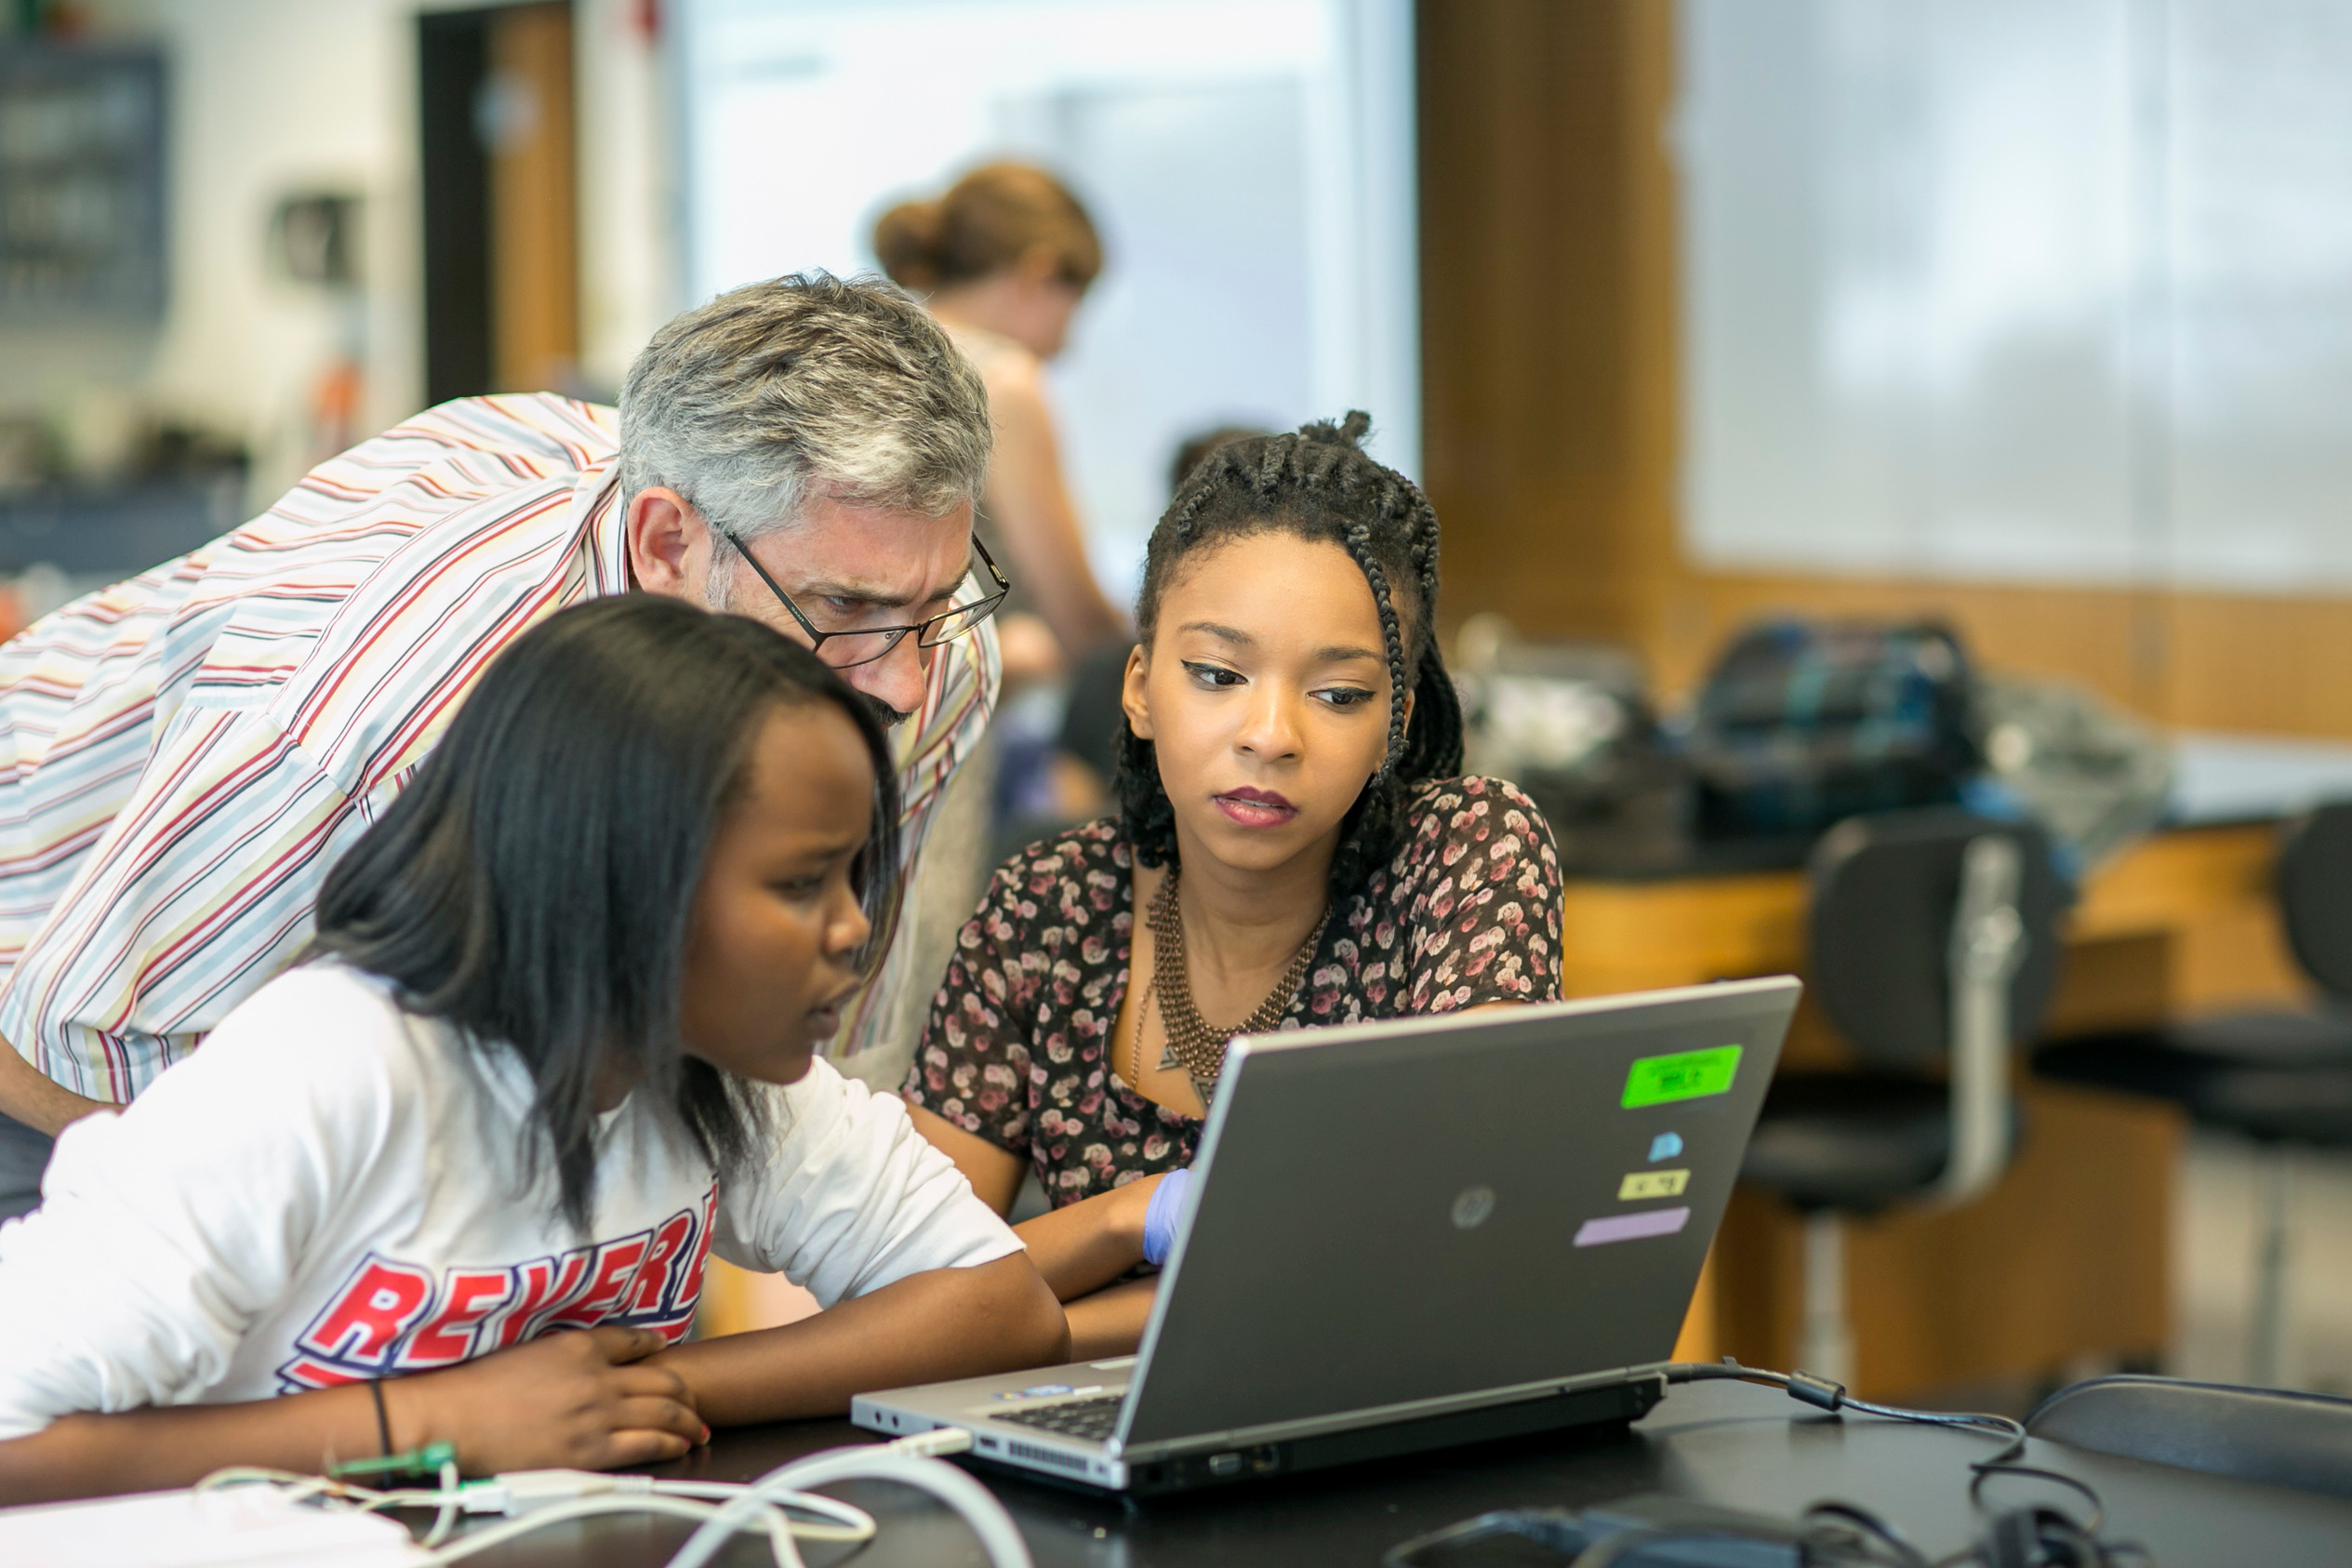
Experiments in and beyond Blended Learning
Notes:
Going fully online in the liberal arts
MOOC
certificate for faculty who will be teaching blended courses
bridge program at Princeton
other experiments

Slide 5
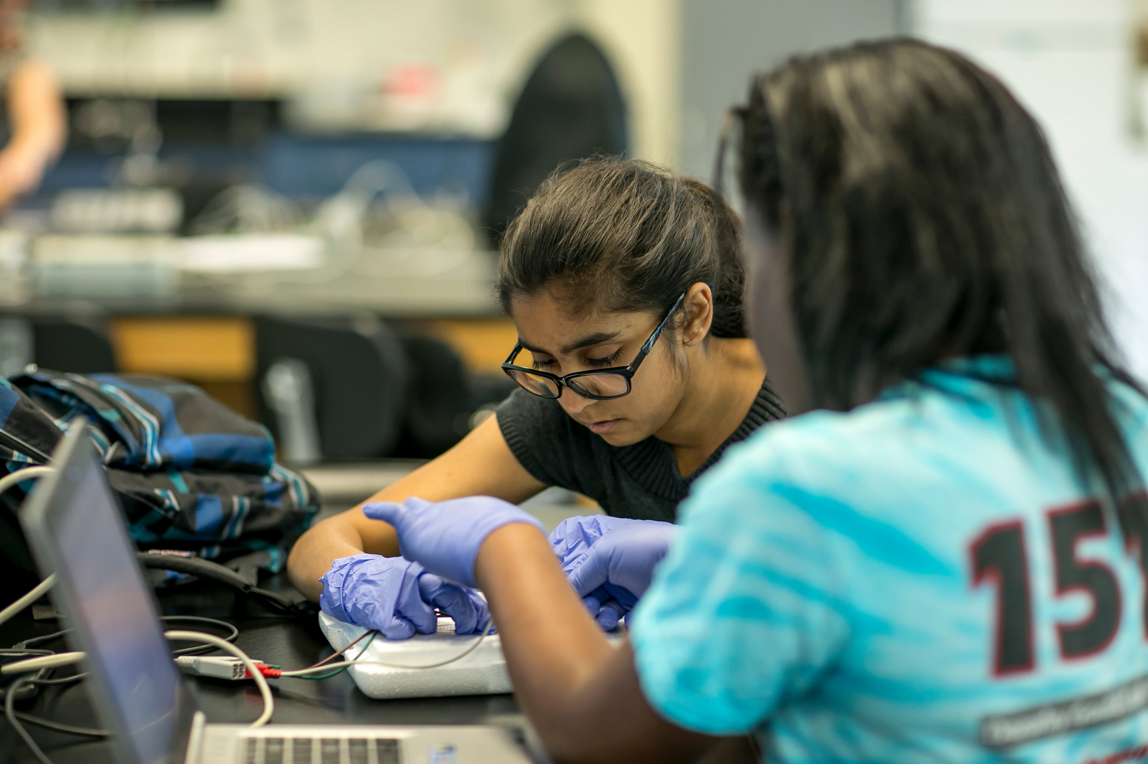
Evolution & Growth
Notes:
Evolution…
Future of the field (postbacs, Agnes Irwin)
Internationalization of the liberal arts / spread to R1s
International participation this year / branching to R1s

Slide 6
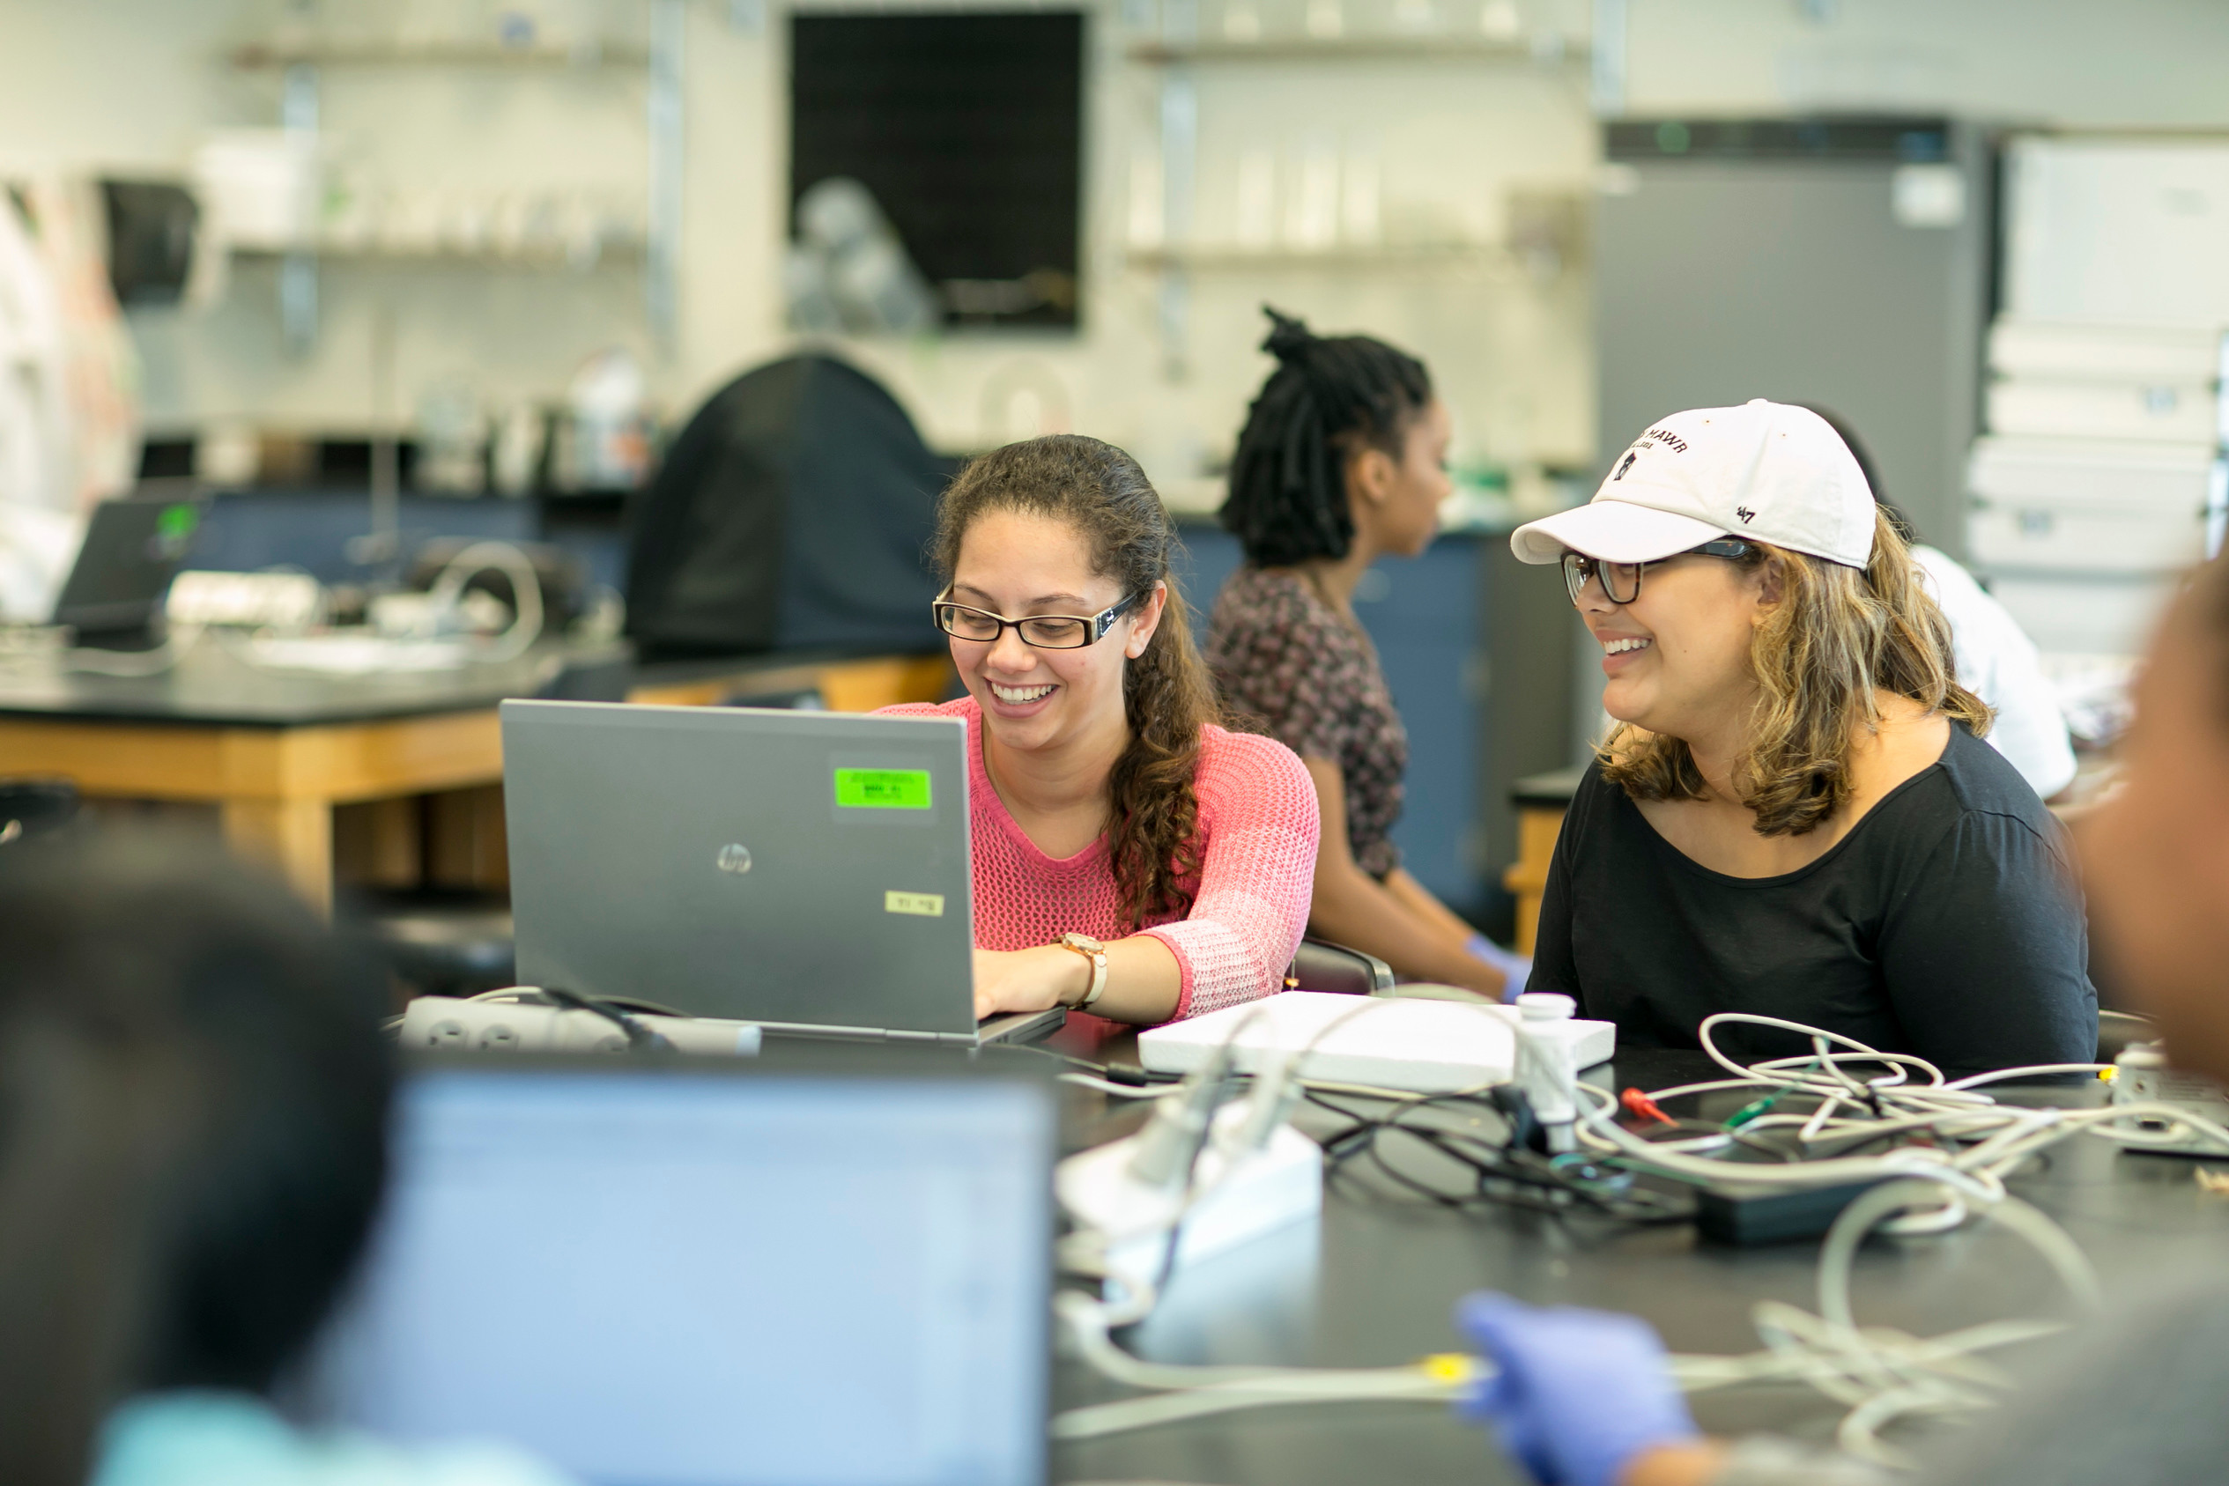
Evolution & Growth
Notes:
Evolution…
Future of the field (postbacs, Agnes Irwin)
Internationalization of the liberal arts / spread to R1s
International participation this year / branching to R1s

Slide 7
For Reflection & Sharing with a Colleague:
In your context, what are the major factors that motivate (you as) faculty to integrate technology into courses or into the curriculum?
What are the major barriers that impede experimentation or investment in these practices?
Notes:
Themes this year…
Faculty development
Assessment

Slide 8
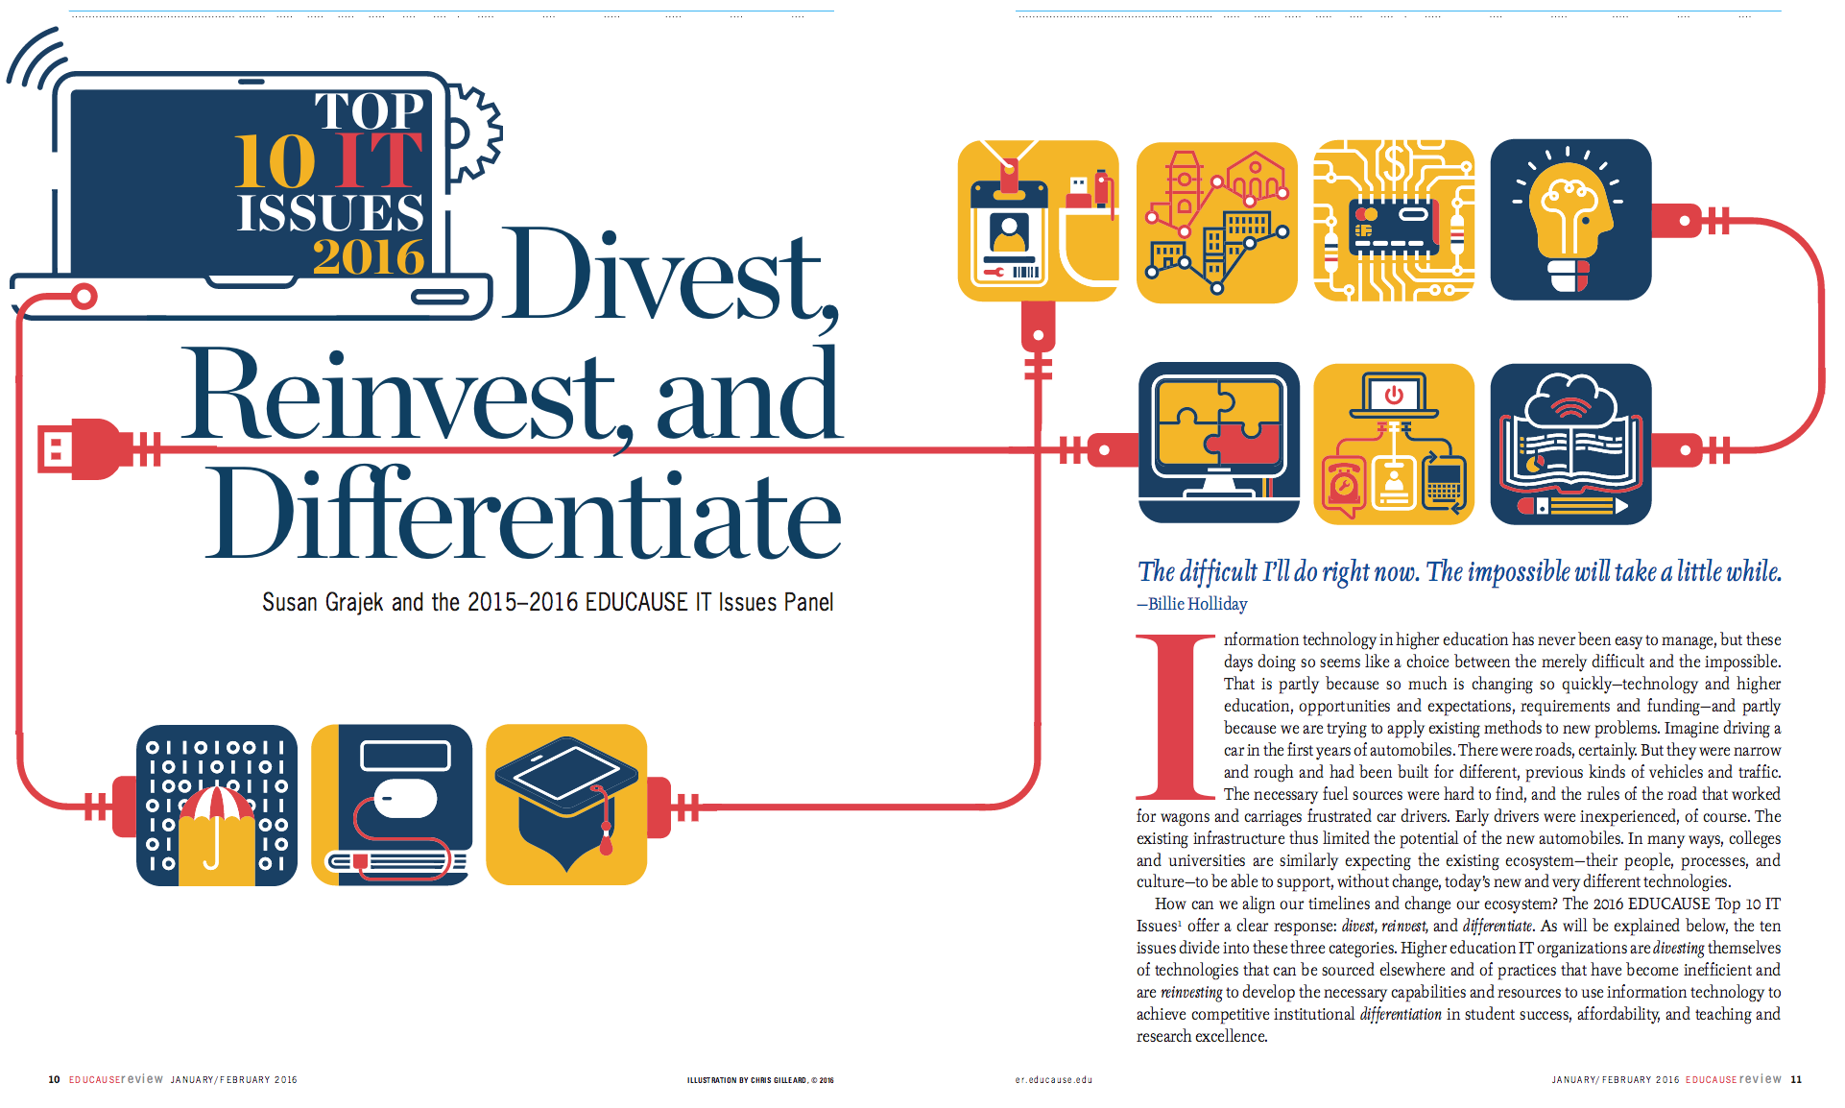

Slide 9
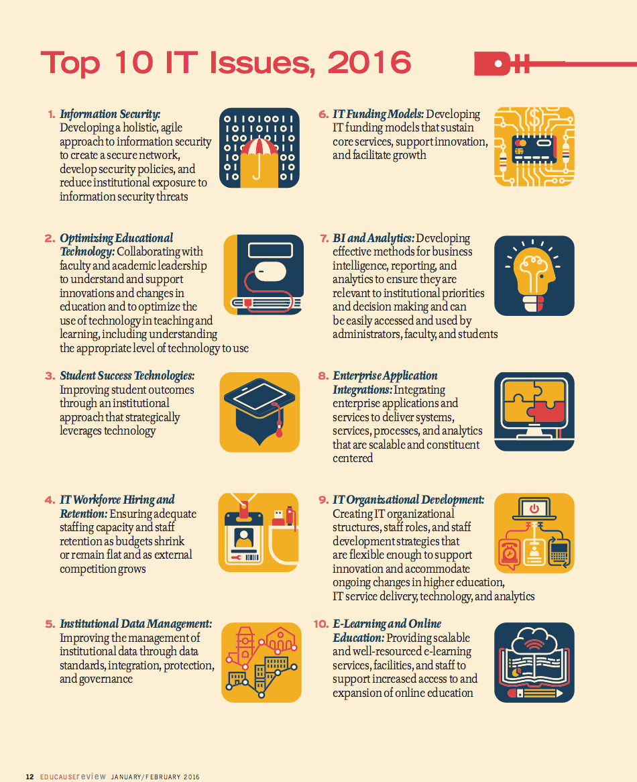

Slide 11
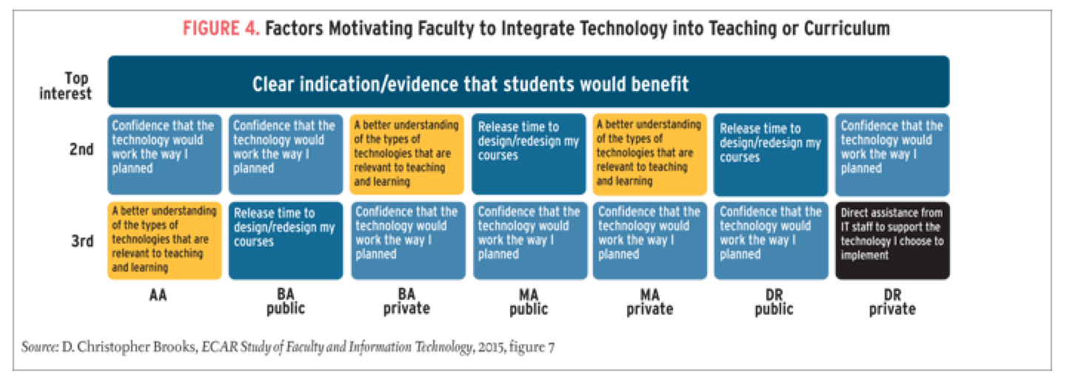
Clear indication/evidence that students would benefit.
A better understanding of the types of technologies that are relevant to teaching and learning.
Confidence that the technology would work the way I planned.

Slide 12
For Reflection & Sharing with a Colleague:
In your context, what evidence do you collect and share about how a particular technology-enhanced teaching or learning approach works for students?
How do folks in your communities of practice inspire one another with examples of what’s possible and help those with trepidation to get beyond the barriers?

Slide 13
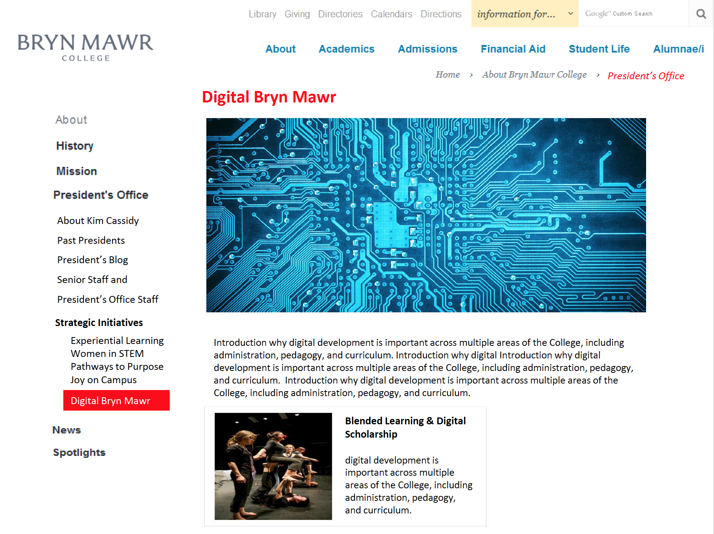

Slide 14
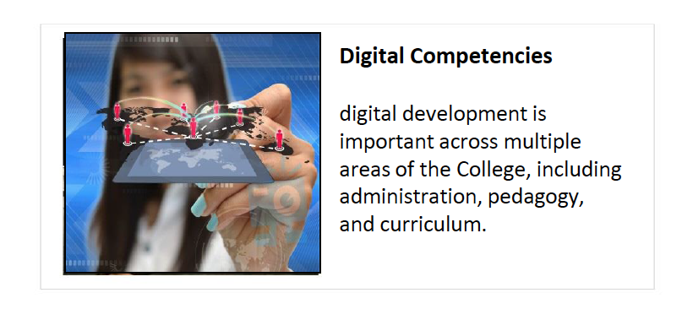

Slide 15
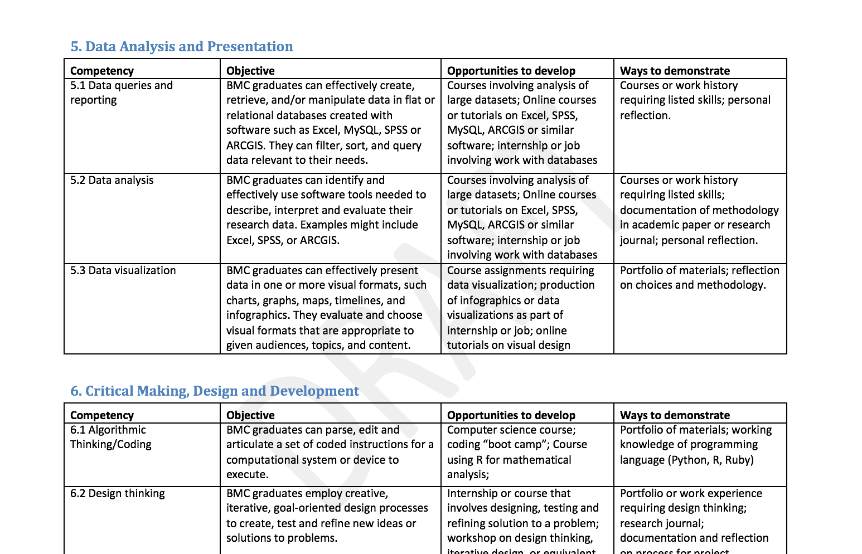

Slide 16
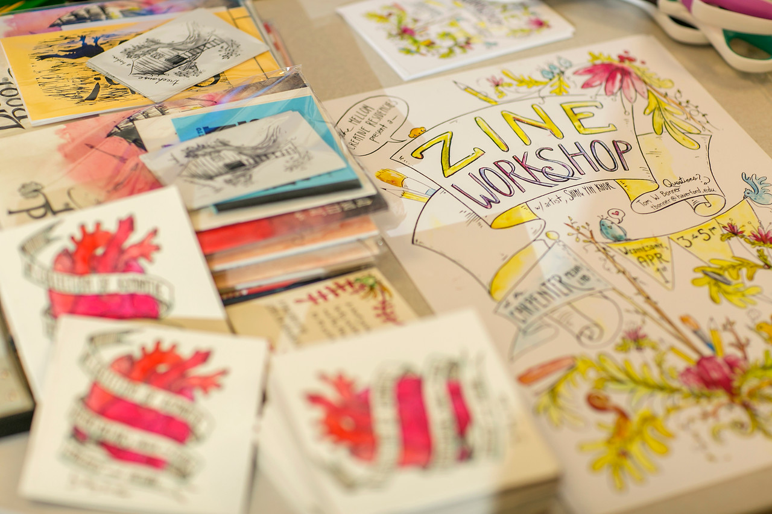
From Digital Fluency to Critical Making
Notes:
Spread across disciplines
Continuum of ed tech to digital scholarship (Annette Baertsche’s course project, Tom Morton’s Cities project, Media in Cars, Amherst)

Slide 17
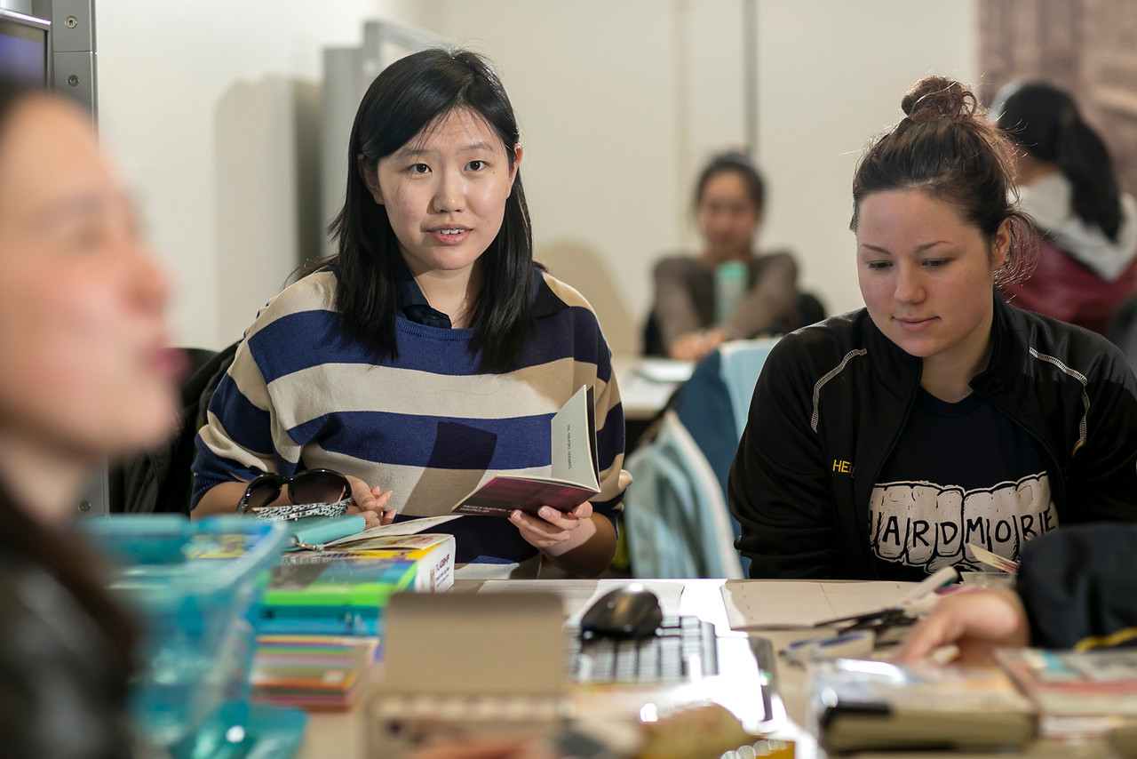
From Digital Fluency to Critical Making
Notes:
Spread across disciplines
Continuum of ed tech to digital scholarship (Annette Baertsche’s course project, Tom Morton’s Cities project, Media in Cars, Amherst)
Digital to Critical Making

Slide 18
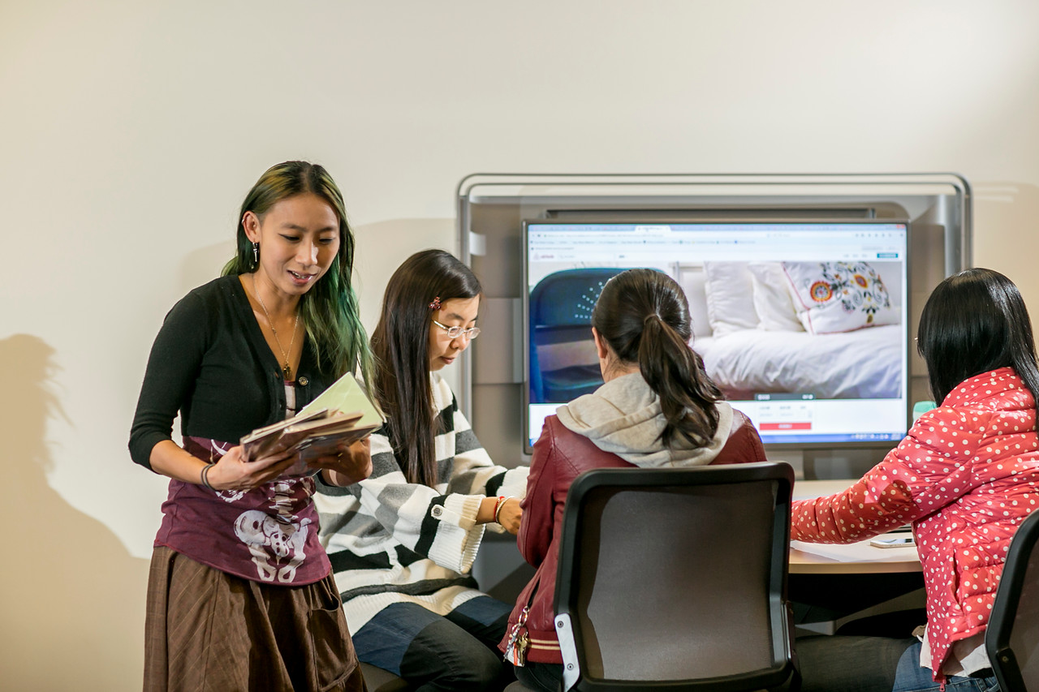
From Digital Fluency to Critical Making
Notes:
Spread across disciplines
Continuum of ed tech to digital scholarship (Annette Baertsche’s course project, Tom Morton’s Cities project, Media in Cars, Amherst)
Digital to Critical Making

Slide 19
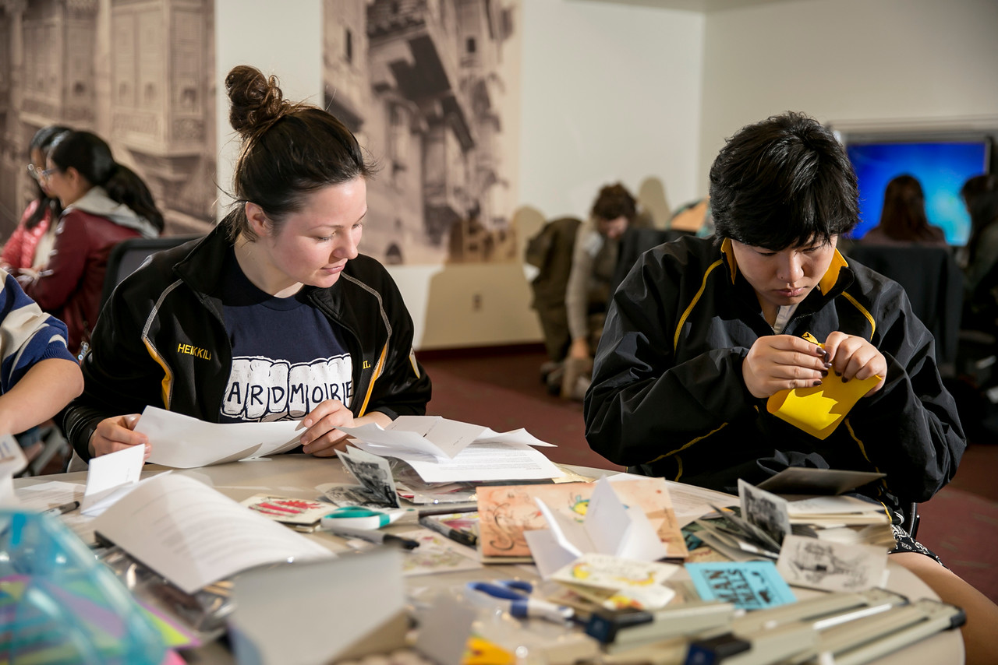
From Digital Fluency to Critical Making
Notes:
Spread across disciplines
Continuum of ed tech to digital scholarship (Annette Baertsche’s course project, Tom Morton’s Cities project, Media in Cars, Amherst)
Digital to Critical Making

Slide 20
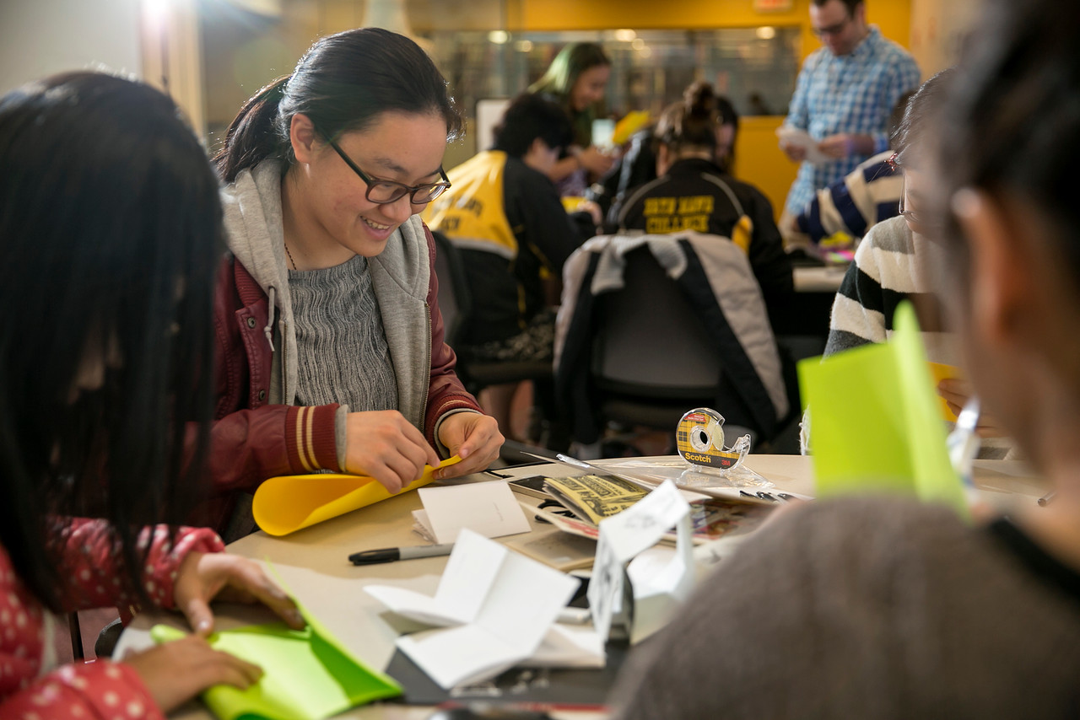
From Digital Fluency to Critical Making
Notes:
Spread across disciplines
Continuum of ed tech to digital scholarship (Annette Baertsche’s course project, Tom Morton’s Cities project, Media in Cars, Amherst)
Digital to Critical Making

Slide 21
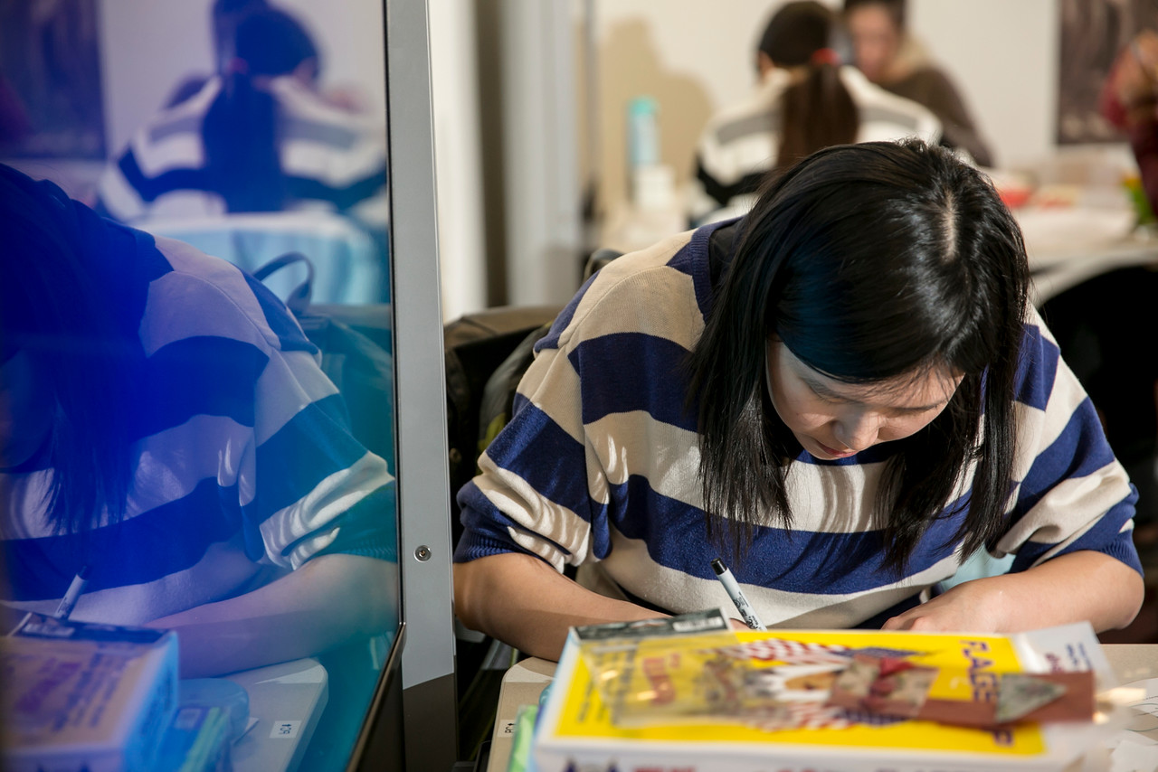
From Digital Fluency to Critical Making
Notes:
Spread across disciplines
Continuum of ed tech to digital scholarship (Annette Baertsche’s course project, Tom Morton’s Cities project, Media in Cars, Amherst)
Digital to Critical Making

Slide 22
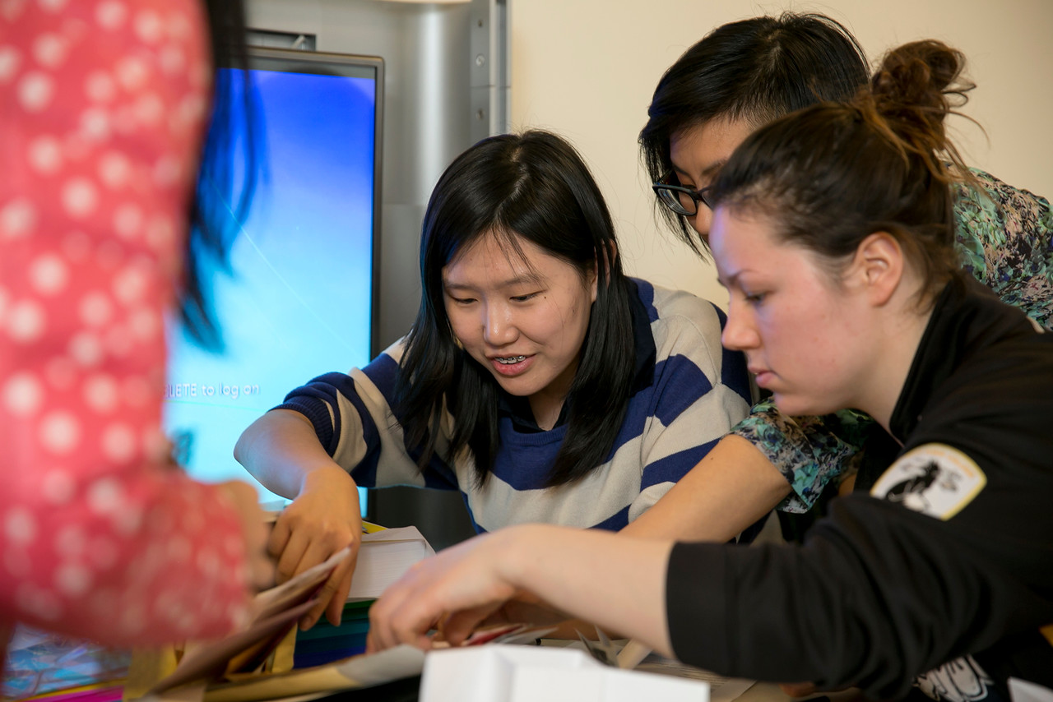
From Digital Fluency to Critical Making
Notes:
Spread across disciplines
Continuum of ed tech to digital scholarship (Annette Baertsche’s course project, Tom Morton’s Cities project, Media in Cars, Amherst)
Digital to Critical Making

Slide 23
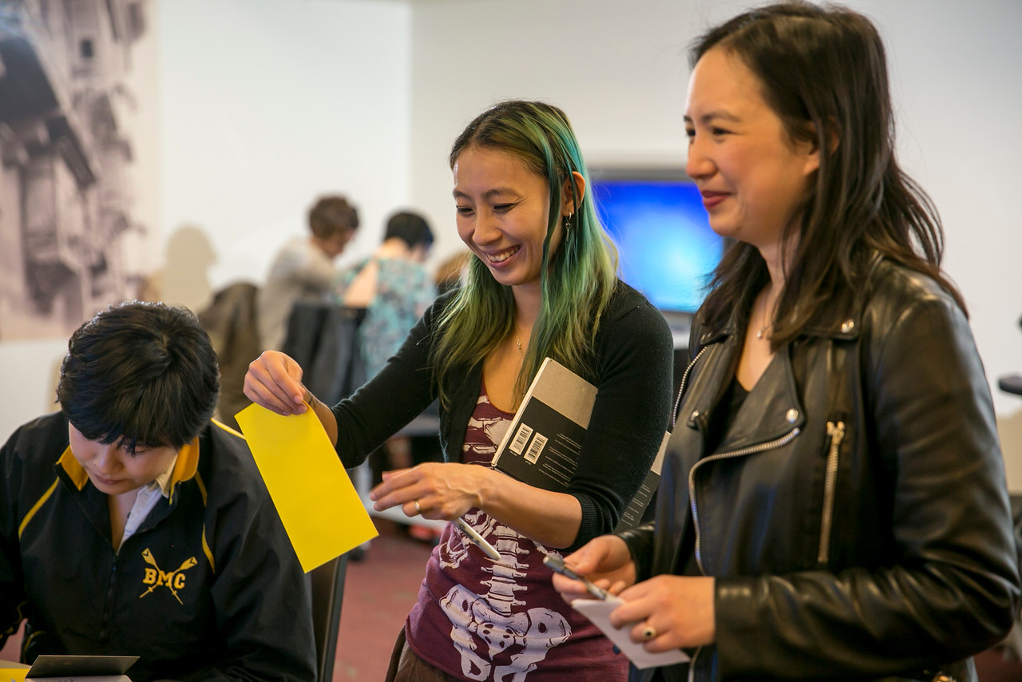
From Digital Fluency to Critical Making
Notes:
Spread across disciplines
Continuum of ed tech to digital scholarship (Annette Baertsche’s course project, Tom Morton’s Cities project, Media in Cars, Amherst)
Digital to Critical Making

Slide 24
Minute for Reflection (and possible tweeting - #BlendLAC16):
Is there a takeaway for you coming out of this welcome session and your brief conversations with peers?
What lingering question(s) will you carry into the conference sessions and conversations this afternoon and tomorrow?

Slide 25
Have a wonderful conference!
#BlendLAC16

