Slide 1
Ethics in the Digital Age:
Innovating Ethics Education in the Liberal Arts
Blended Learning in the Liberal Arts
May 19, 2016
Cara Biasucci, M.F.A.
McCombs School of Business
The University of Texas at Austin

Slide 2
Ethics Curriculum Integration Initiative
+
Supported by Teagle Foundation & UT Provost’s Office
2014 – 2016
Notes:
----- Meeting Notes (2/16/16 23:33) -----
I'm going to talk a little bit about a projec that's going on now at the UT campus called the Ethics Curriculum INtegration Initative.
Jess and I worked on this initative together. We combined the resources of Ethics Unwrapped with the programmatic mechanism of the Ethics and Leadership Flag to expand ethics education on the UT campus.

Slide 3
Our BIG Questions
What does the digital era bring to ethics education?How can we best meet those challenges?
How do we support trends toward interdisciplinarity?
What pedagogical resources will serve our own campus and the needs of instructors elsewhere?

Slide 4
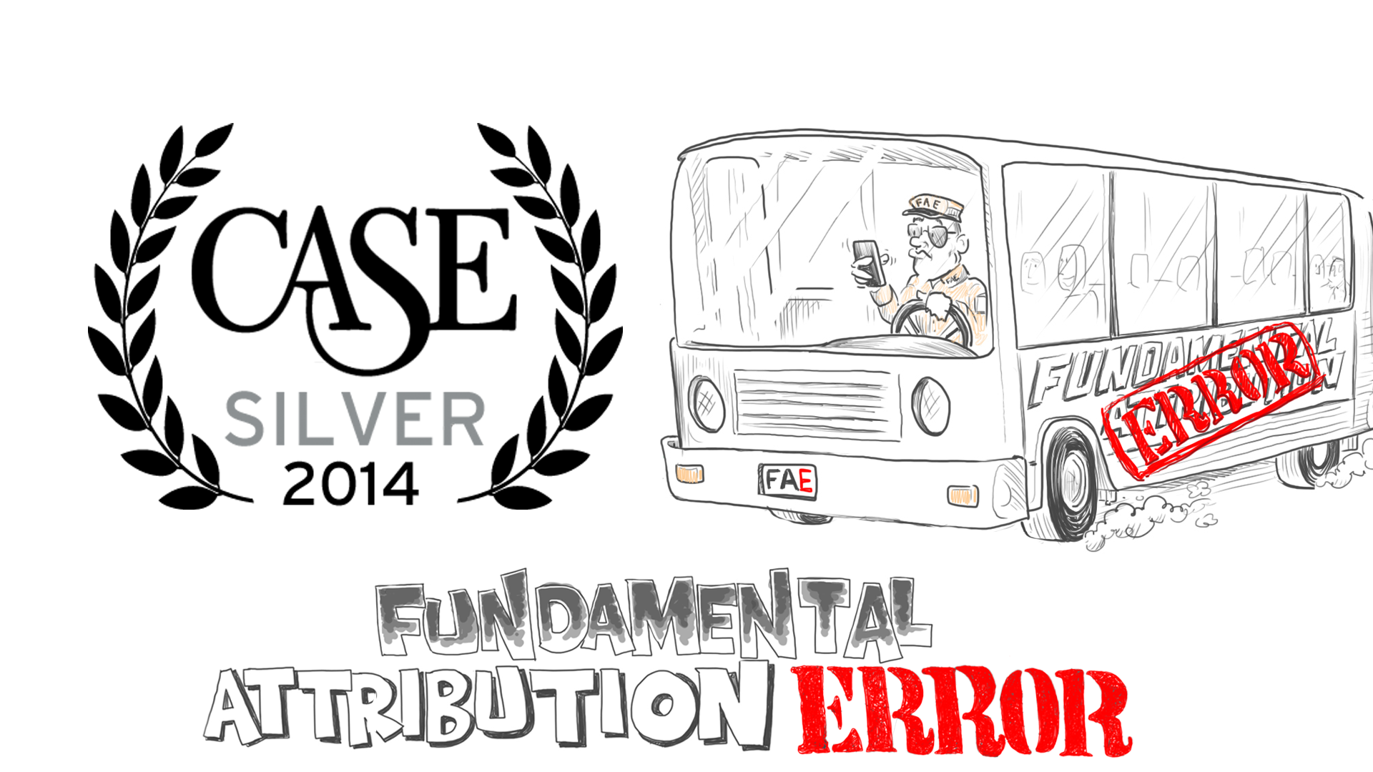
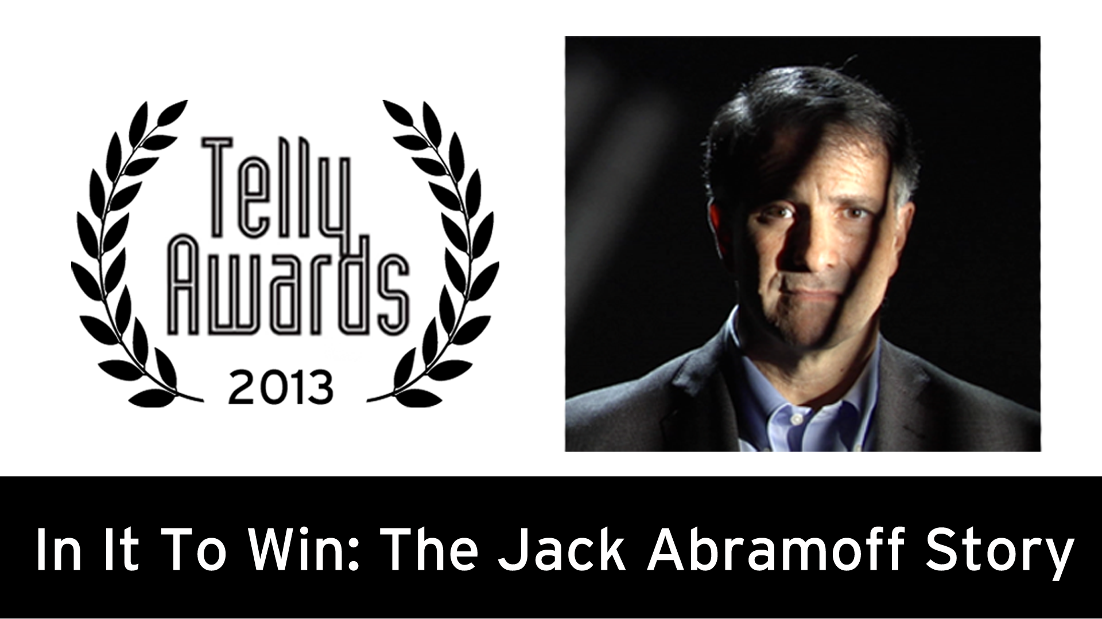
Ethics Unwrapped
48 high-quality, research-based videos
Supported by 20+ case studies and additional teaching resources
Easily accessible online and FREE
Used at 500+ colleges and universities in 170+ countries
~ 500,000 YouTube views
Winner of 7 awards

Slide 5
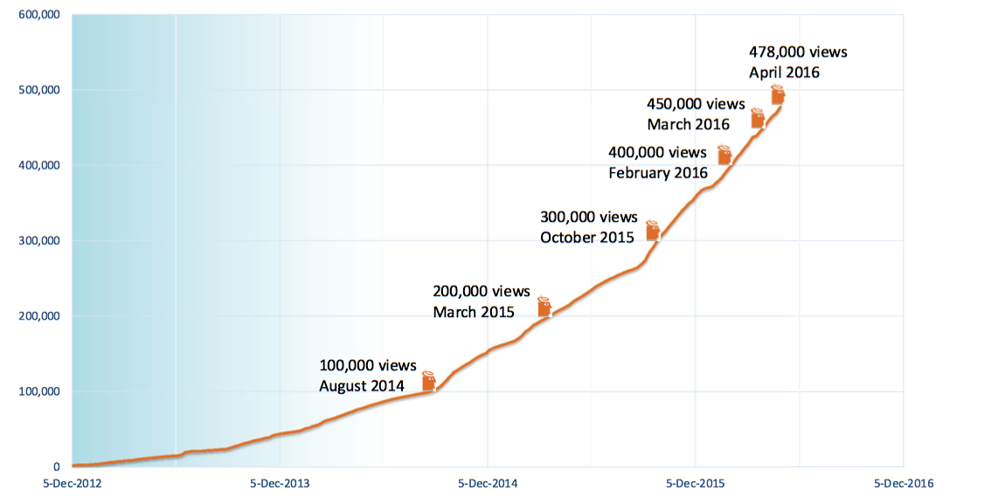
Growth in Program Views (2012 – 2016)

Slide 6
“It’s a new day: Gen Zers indulge in a significant amount of daily screen time (more than 52 percent) and are often looking to be entertained in the classroom.”
- B. Denise Hawkins
“Here Comes Generation Z. What Makes them Tick?,”
NEA Today, July 13, 2015

Slide 7
Focus on Behavioral Ethics
The study of how and why people make the ethical (and unethical) decisions that they do.
It adds to the contributions of philosophy and theology learning from fields such as:
Behavioral Psychology
Evolutionary Biology
Cognitive Neuroscience
Game Theory
Anthropology
Why do people have the
ethical values that they do?
Why do good people do bad things?
How can we improve people’s ethical decision making?

Slide 8
Behavioral Ethics: Bottom Line
We see what we are looking for, which can dim moral awareness, and is further exacerbated by…
Social & organizational pressures
Psychological biases (Cognitive heuristics)
Situational factors

Slide 9
Ethics Unwrapped
33 short animated videos
Ethics concepts
Experts
Student interviews
8 short animated videos
Values-driven leadership
Mary Gentile
Graduate student interviews
25 min. Documentary +
6 short videos
Profile Jack Abramoff
Ethics Case Study
www.ethicsunwrapped.utexas.edu

Slide 10
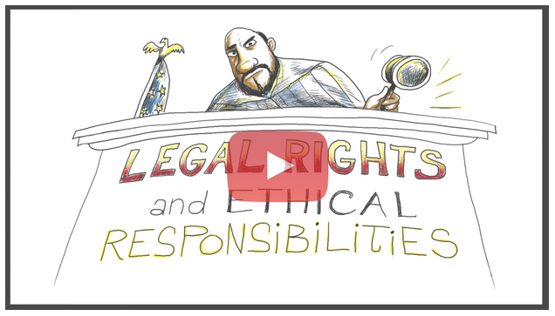
Teaching Resources for Ethics Unwrapped
20+ Case Studies
Classroom Discussion Questions
Case Study Discussion Questions
Teaching Notes
Bibliography
List of Additional Readings
Transcript of Video Narration
Available in Spanish

Slide 11
Ethics & Leadership Flag
Campus-wide initiative
1 of 6 new academic skills requirements for undergraduate students
33% of grade must be based on practical ethics component
First flagged courses offered in 2009; fully implemented by Fall 2016
Ethical Awareness
Ethical Reasoning
Ethical Action

Slide 12
Observations & Challenges
Flag requirement put a system of accountability and assessment in place
Instructors and departments eager for teaching resources
EL Flag failed attempt at Instructor Resource Wiki
Variety of classroom formats: traditional, blended, and online courses
Classes range from relatively small to very large (up to 1500 students)
No Ethics Center – Ethics Unwrapped filled void

Slide 13
Curriculum Integration Goals
Sustainable and replicable
Accessibility
Adaptive and responsive; suitable for cross-disciplinary use
Geared toward practical ethics (improve awareness and reasoning)
Faculty input and feedback on teaching resources
Work with online, blended, and traditional classrooms
Target core undergraduate courses
Assess efficacy of Ethics Unwrapped videos
Notes:
----- Meeting Notes (2/16/16 23:33) -----
We had several goals with the project. We wanted to design something that would last beyond the two years and could be replicated at UT and on other campuses. We wanted to assess the efficacy of the videos. We could see they were popular, but we didn't know if they were effective as teaching tools. We wanted faculty feedback on our resources and their help in developing additional teaching materials.
We decided to run project across a variety of classrooom formats to see how the tools worked in different learning environments. And, to get the most bang for our buck, we decided to target large core courses - requirements for undergraduates, required courses for majors in Fine Arts, for example.

Slide 14
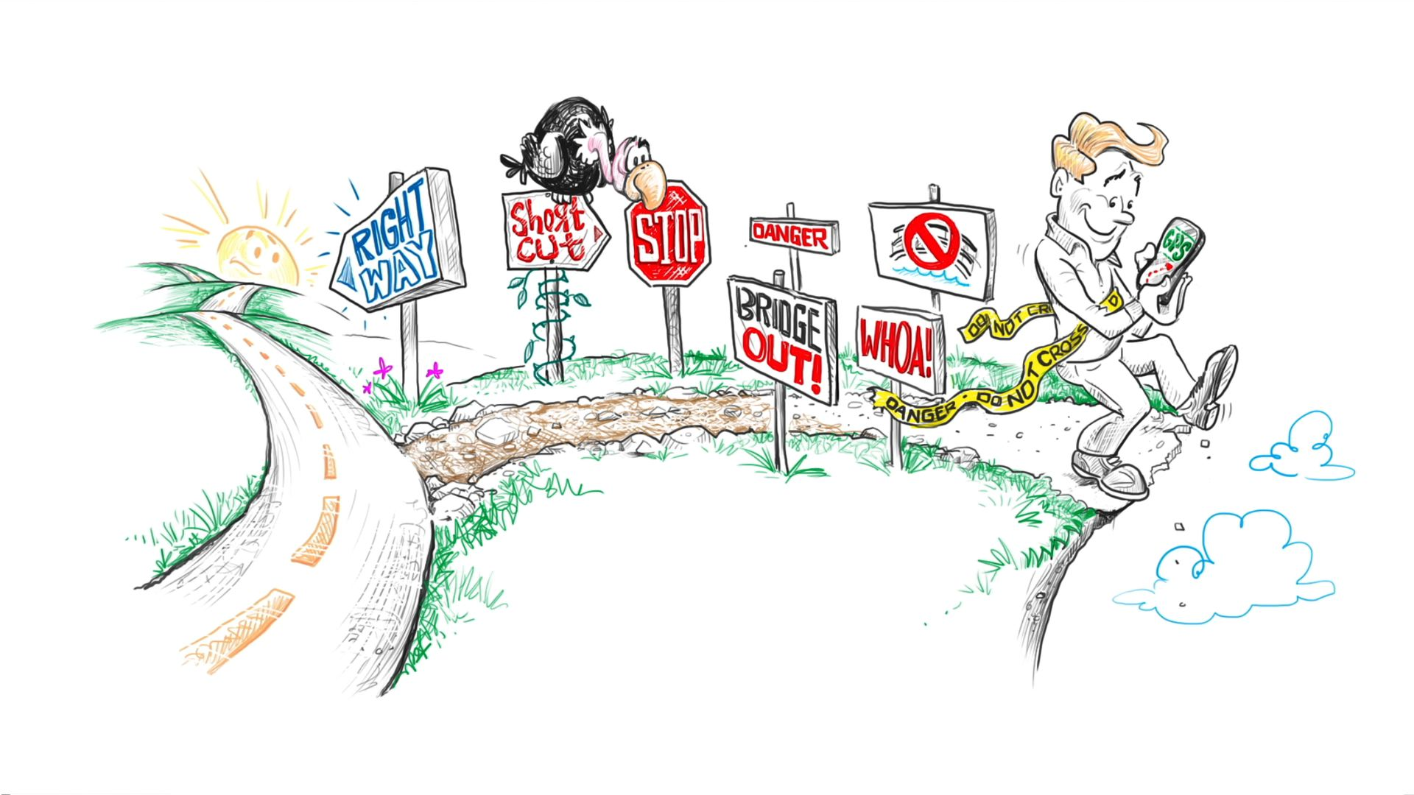
Integrated Ethics Unwrapped videos into 25 courses in 7 colleges:
College of Liberal Arts
College of Fine Arts
Moody College of Communication
College of Education
School of Social Work
College of Natural Sciences
McCombs School of Business

Slide 15
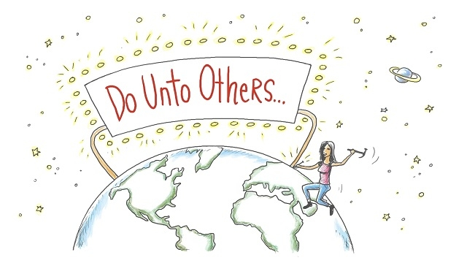
2014-15: Curriculum Integration Initiative
Engaged 3 colleges: Liberal Arts, Fine Arts & Education
Produced 8 new videos
Wrote 19 case studies
Modified 16 courses
Integrated 28 videos
Worked with 17 instructors and 32 teaching assistants
Surveyed ~2,200 students
Reached more than 3,200 students
Course included:
The American Presidency
Languages of the Stage
Ethics in Music
Introduction to the Holocaust
US Foreign Policy
Notes:
----- Meeting Notes (2/16/16 23:33) -----
In the first year, we worked with faculty at three colleges - COLA, COFA and Education - to modify or design 16 courses. Jess and her team worked with about 17 instructors and almost 3 dozen teachign assistants. We polled the faculty in COLA and COFA for a list of ethics concepts that would be helpful for them and developed a dozen videos on those concepts. It become apparent that case studies were needed so we worked with faculty to write about 20 cases for the website around the ethics concepts in the videos. We surveyed about 2,200 students - and I'll show you those results in a minute.

Slide 16
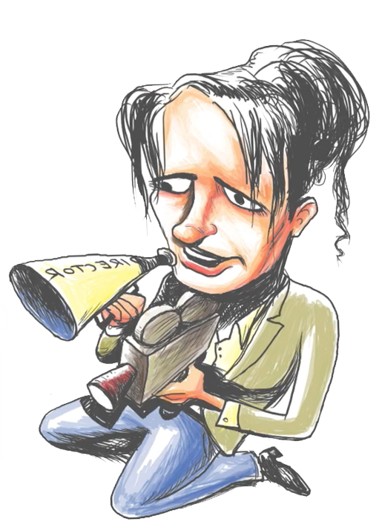
2015-16: Curriculum Integration Initiative
Added 2 more colleges: Natural Sciences & Communication
Produced 4 new videos
Writing 30 case studies
Integrated 31 videos
Modified 9 more courses
Working with 29 instructors and 30+ teaching assistants
Surveying instructors
Surveying ~4,000 more students
Reaching ~ 4,600 more students
Additional courses:
Chemistry Peer Mentors in Research and Teaching
Communicating Sustainability
Notes:
----- Meeting Notes (2/16/16 23:33) -----
This year - our second and final year of the Initative - we've added two more colleges - Natural Sciences and COmmunications. We retained almost all the courses from last year and added 9 more courses. We're working with about 30 instructors to integrat about 30 vidoes and write an additional 30 case studies. We like the number 30 apparently. We're also continuing to survey the students - we'll reach another 4,000 or so this year.

Slide 17
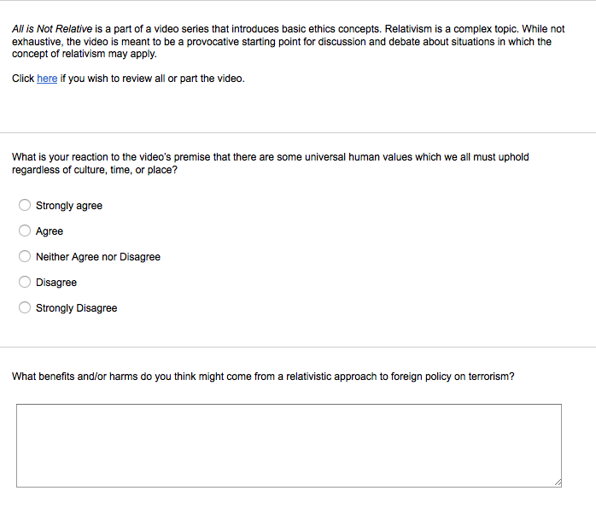
Integration Example: U.S. Foreign Policy
Course prompts in response to “All is Not Relative” video

Slide 18
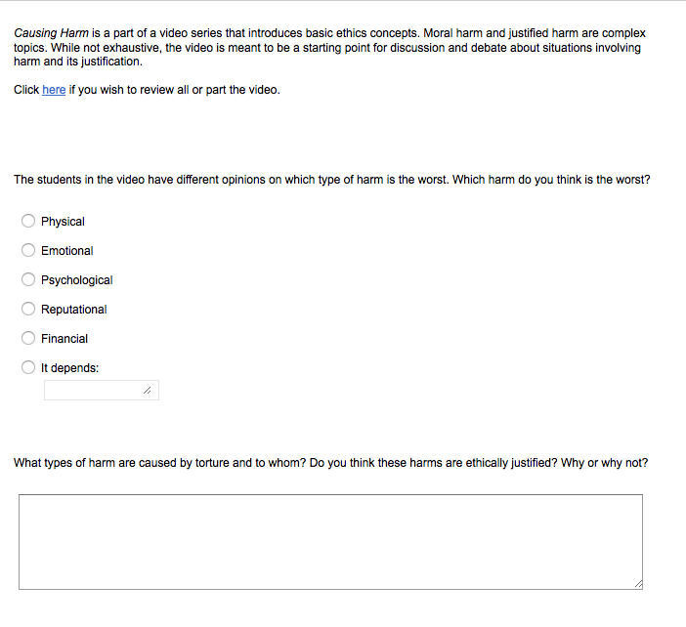
Integration Example: U.S. Foreign Policy
Course prompts in response to “Causing Harm” video

Slide 19
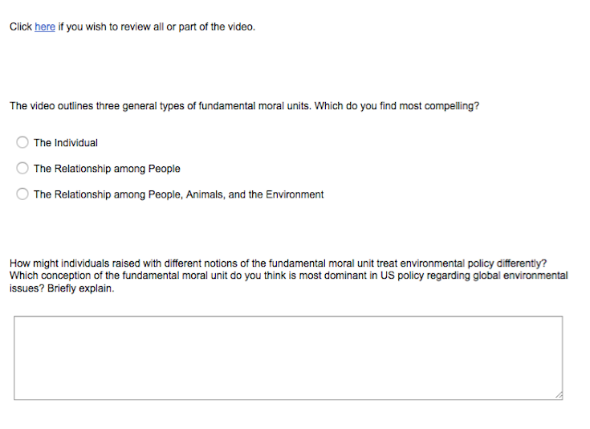
Integration Example: U.S. Foreign Policy
Course prompts in response to “Fundamental Moral Unit” video

Slide 20
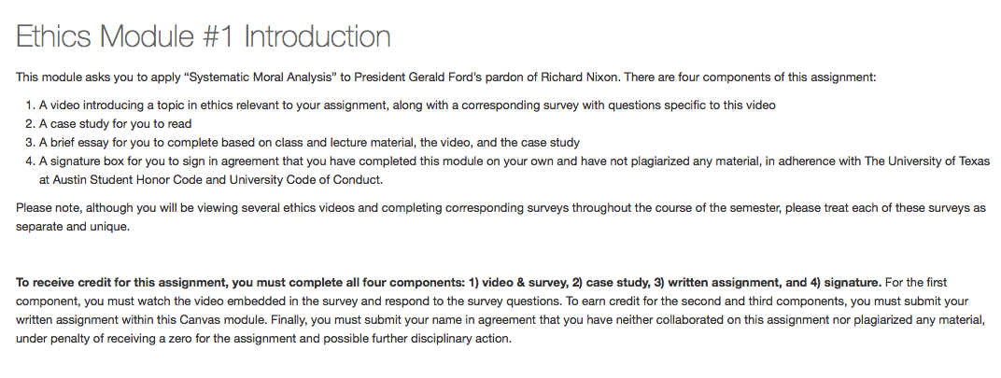
Integration Example: The American Presidency
Canvas assignment Ethics Module #1: “Systematic Moral Analysis”

Slide 21
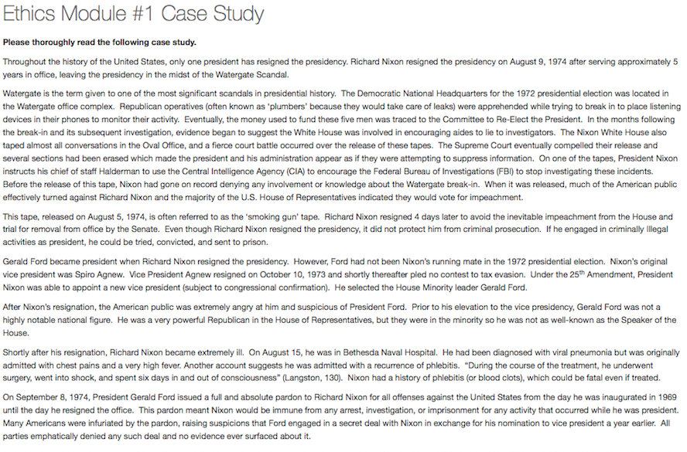
Integration Example: The American Presidency
Canvas assignment Ethics Module #1: “Systematic Moral Analysis”

Slide 22
Integration Example: The American Presidency
Canvas assignment Ethics Module #1: “Systematic Moral Analysis”

Slide 23
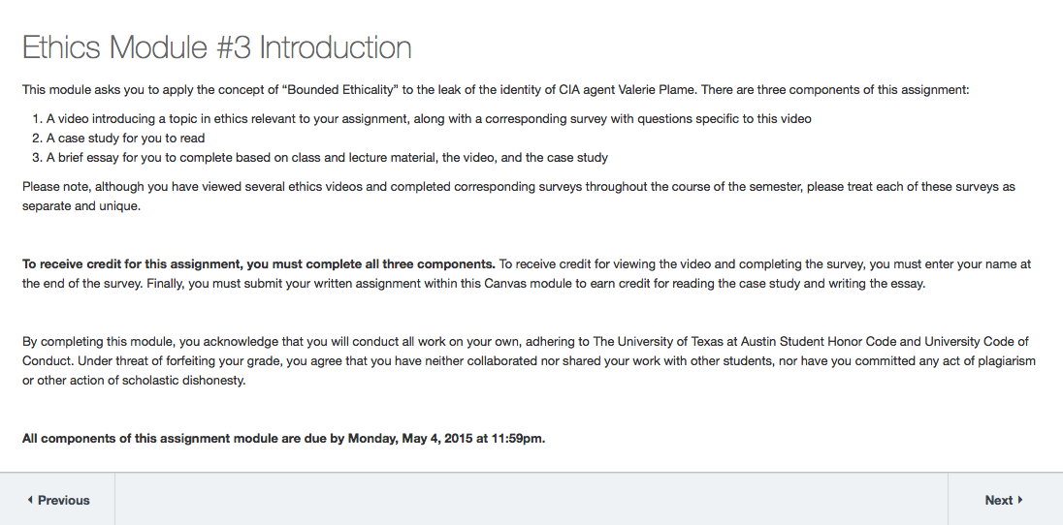
Integration Example: The American Presidency
Canvas assignment Ethics Module #3: “Bounded Ethicality”

Slide 24
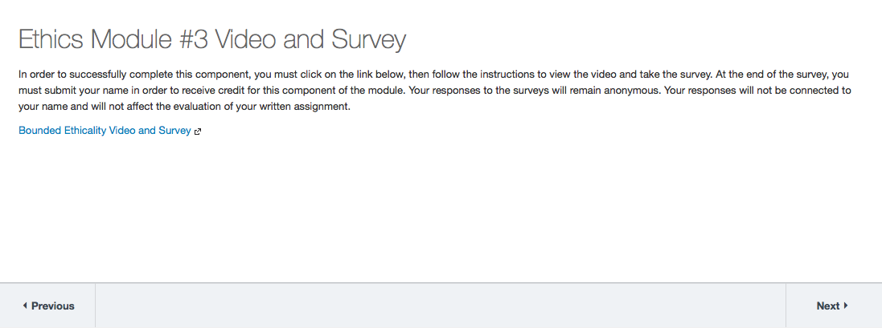
Integration Example: The American Presidency
Canvas assignment Ethics Module #3: “Bounded Ethicality”

Slide 25
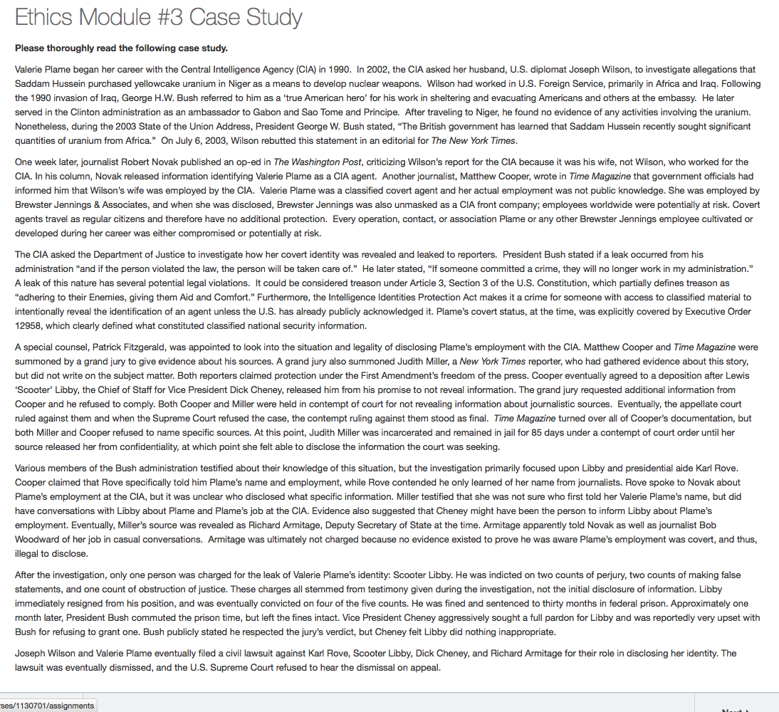
Integration Example: The American Presidency
Canvas assignment Ethics Module #3: “Bounded Ethicality”

Slide 26
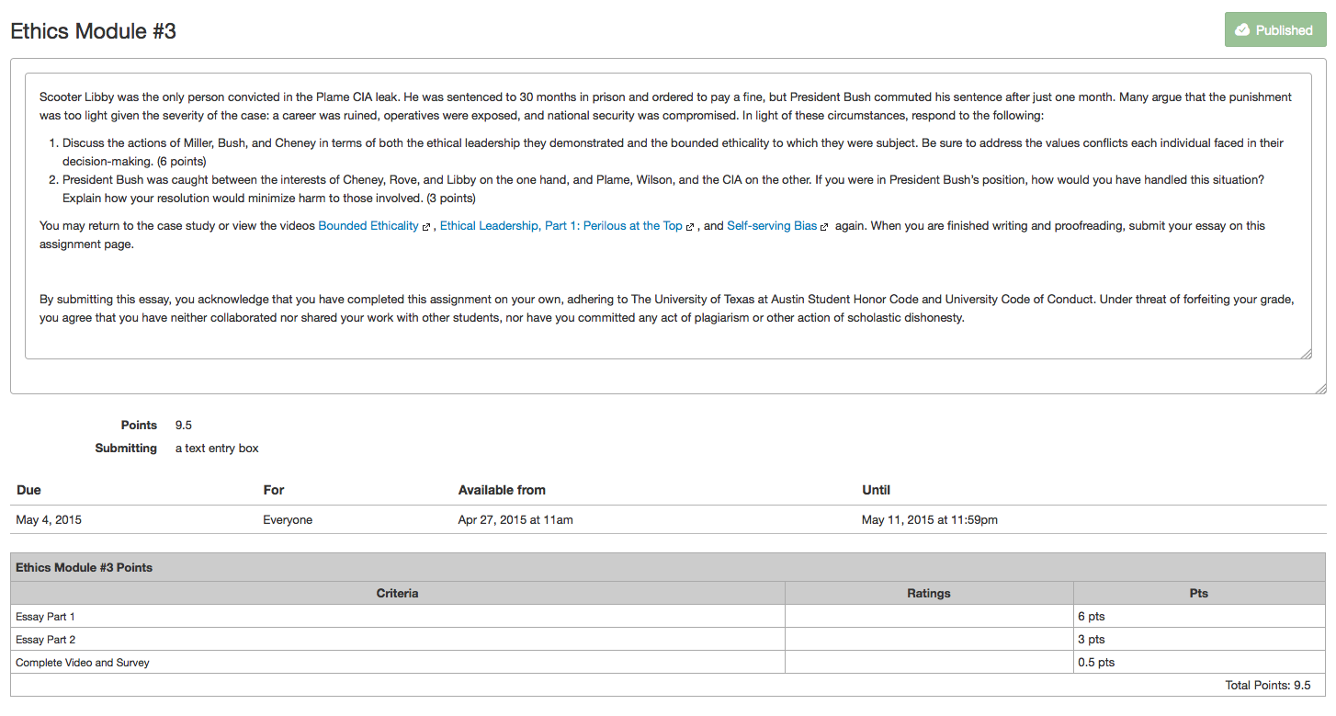
Integration Example: The American Presidency
Canvas assignment Ethics Module #3: “Bounded Ethicality”

Slide 27
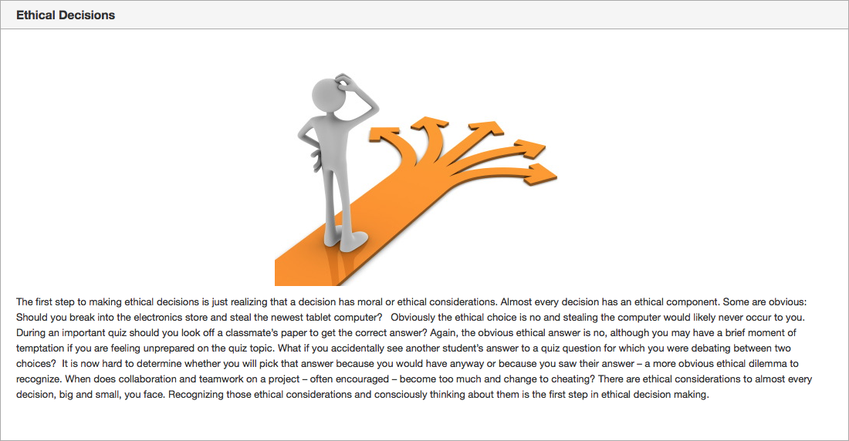
Integration Example: Chemistry Peer Mentors Class
Canvas learning module for flipped classroom environment

Slide 28
Integration Example: Chemistry Peer Mentors Class
Canvas learning module for flipped classroom environment

Slide 29
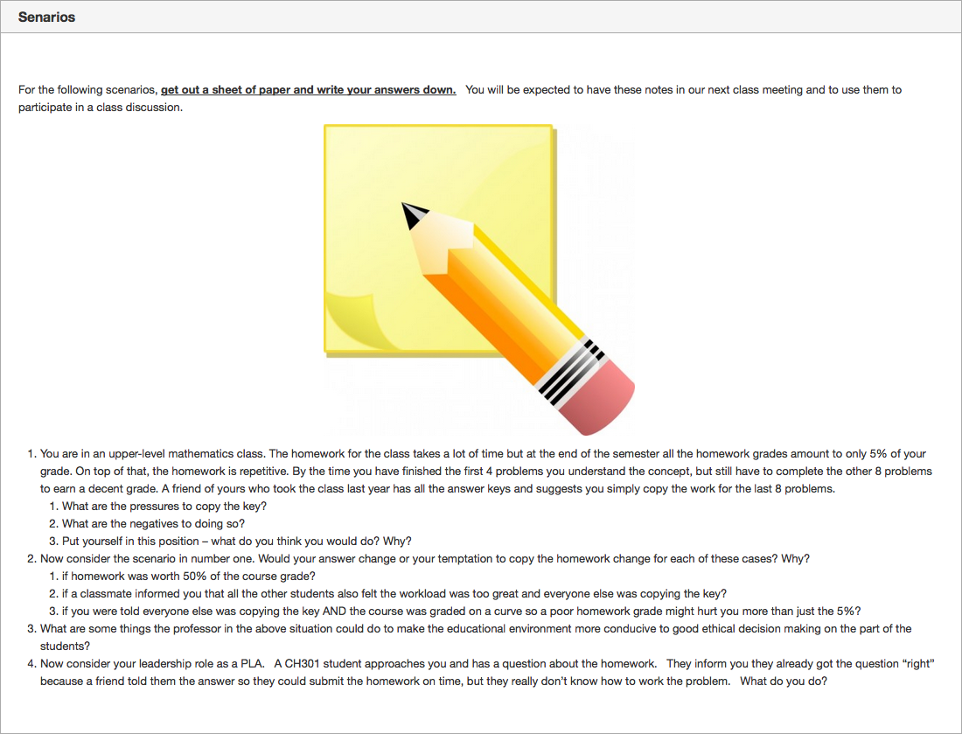
Integration Example: Chemistry Peer Mentors Class
Canvas learning module for flipped classroom environment

Slide 30
Integration Example: Chemistry Peer Mentors Class
Canvas learning module for flipped classroom environment

Slide 31
Video Assessment: Helpfulness for Learning
“How helpful was the video for explaining the ethics concept _________?”
(Survey results from ~4,500 students over three semesters, 2014 – 2015)
90% of students found them helpful to learning

Slide 32
Video Assessment: Student Confidence Levels
“Rate your confidence in your ability to identify, explain, engage in a conversation about, and make an informed decision based on the ethics concept _________ both before and after watching this video.”
Very Confident
14%
Not Confident
24%
Very Confident
41%
Confident
31%
Confident
47%
Minimally Confident
31%
Minimally
Confident
10%
BEFORE
AFTER
78% of students not confident in their ability to identify or apply ethics concepts reported a rise in confidence levels after viewing the video
Notes:
----- Meeting Notes (2/16/16 23:33) -----
We also asked students to rate their confidence levels in their ability to identify, explain, engage in a conversation about, and make an informed decision based on the ethics concept presented in the video. We asked them to rate themselves twice. First, right after watching the video. And then we asked students to think back to before they watched the video - how confident where they that they could have done these things then - and to rate themselves again. Almost 80 % of students who were not confident in their knowledge of the ethics concept before watching the video became confident after watching a video.

Slide 33
Video Assessment: Student Comments
21% General praise
16% General criticism
14% Utility of videos
14% How to improve videos
11% Deeper topic engagement
5 % Off-topic comments
“The animations kept me really engaged and the student comments made me feel that the issues being discussed were pertinent to today's society and everyday issues.”
“I really enjoyed how different people were able to give their perspectives and discuss their thoughts on the subject. ”
“The student comments are fairly interesting and I see why it's beneficial to have real-world examples from people, but I'd still prefer having shorter videos that stuck straight to the definitions and concepts.”
Spend a little more time on the vocab/names of each type of ethical dilemma and less on the student perspectives, although the real life examples were helpful to connect ideas.
“This has really opened up my eyes to my own practice of relativism and now I feel better about how I express myself on certain issues.”
“This video is engaging but superficial. It does not give any indication of how one would adjudicate serious conflicts between competing values in a way that would yield a definitive resolution and not just be a recourse to "relativism.”
Notes:
----- Meeting Notes (2/16/16 23:33) -----
We also did an analysis of the student comments. About 10% of students commented on the surveys. These half dozen themes emerged. 21% had all good things to say, about 16% offered criticism, about 14% spoke of the usefulness of the videos and about another 14% offered specific way to improve the videos. Another 11% of the comments showed a deeper engagement with the topic and there were about 5% of comments that were completley off topic. Here are some representative comments. One idea that surfaced repeatedly in the critcisms and ways to improve was to include a concise defintion of the concept right up front before jumping into a discussion of the idea.

Slide 34
Video Assessment: Faculty Feedback
How Videos Were Used
Classroom Format
Notes:
----- Meeting Notes (2/16/16 23:33) -----
We've just begun to gather faculty feedback. This represents a very small sample - less than 30 instructors - almost all of whom were part of the Curriculum Integration Inititaive. You can help us out by visting the EThics Unwrapped table in the resources room and filling out a quick survey if you've used our materials. We'd like to get a broader sample than this.
What We can see from our small sample is that about 75% teach in traditional classrooms. About 30% screen the videos in class, just over 30% assign the videos for students to watch outside of class. Another 30% share the videos through online learning environments like Canvas or Blackboard or embed the videos in online modules.

Slide 35
Video Assessment: Faculty Feedback
Helpfulness of Videos
for teaching & learning
Teaching Resources Used
Notes:
----- Meeting Notes (2/16/16 23:33) -----
We asked what resources in addition to the videos did the faculty use and also how helpful they found the videos for teaching and learning in their coures. 95% of faculty found the videos very helpful or helpful. About 45% of instructors used the discussion questions, about 25% used the case studies, another 25% used the teaching notes.

Slide 36
Video Assessment: Faculty Feedback
100% Teaching Resources Helpful
74% Use Ethics Unwrapped Videos again
78% Recommend Ethics Unwrapped to a Colleague
“In my face-to-face classes I use it as reference material so that if students are interested in learning more they know where to go. In my online classes, I use it as optional primer/refresher material.”
“I make students aware of the videos through our course management software so they can watch them outside of class if they like. The main benefit from the Ethics Unwrapped materials I get is the teaching notes/explanations of the concepts, which I use heavily in my course.”
“Helped to illustrate concepts and connect to the students.”
“The videos and their discussion of the ethical concepts are easy for students to understand and relateable. Once they recognize the dynamic, then can use it analytically.”
“Ethics Unwrapped inspired [an] entirely new course and the revision of a proposed course; students very engaged and enjoyed the discussions a great deal. All students reported that they now think differently about issues in music.”
“Ethics unwrapped challenges students to be willing to address issues that otherwise often are a part of the hidden curriculum in teaching and learning. It helps them understand that multiple vantage points exist among themselves and their peers.”
Notes:
----- Meeting Notes (2/16/16 23:33) -----
Not all the faculty used the teaching resources, but of those who did, 100% of them said they were either very helpful or helpful. About 75% of the faculty surveyed would use the videos again and nearly 80% would recommend Ethics Unwrapped to a colleague.
Here are some of the comments that faculty made. We know from being at conferences, and from working with the faculty on the Curriculum Integration Intiative, that knowing what resources to use on our website can pose a problem. We'll have 50 case studies and about as many videos on the site by the end of the summer and it can be overwhelming to try to navigate all that content, especially if you're fairly new to teaching ethics.

Slide 37
Coming Fall 2016…
Ethics Unwrapped Teaching Guide
Behavioral Ethics
Leadership
Media, Arts & Culture
Law & Policy
Professional Ethics
Research Ethics
Organizational Ethics
Sustainability
Introductory Resources

Slide 38
Behavioral Ethics
Leadership
Media, Arts & Culture
Law & Policy
Professional Ethics
Research Ethics
Organizational Ethics
Sustainability
Introductory Resources
Videos:
All is Not Relative
Appropriation & Attribution
Framing
Fundamental Attribution Error
Fundamental Moral Unit
Moral Agent & Subject of Moral Worth
Moral Myopia
Legal Rights & Ethical Responsibilities
Representation
Case Studies:
Conversation Starter
- The Miss Saigon Controversy
Fine Arts, Humanities & Social Sciences
- Artistic Appropriation and Shepard Fairey’s “Hope”
- Christina Fallin: “Appropriate Culturation?”
- The “Blurred Lines” of Copyright
- Bullfighting
- Digital Downloads
Professions
- Teaching Blackface: A Lesson on Stereotypes
- Grantland and Dr. V
- Covering Robin Williams
Glossary Terms:
Moral Absolutism
Moral Relativism
Media, Arts & Culture:
A number of ethical dilemmas may arise across various media, arts, and cultures: from copyright infringement or biased framing of a news report, to cultural insensitivity or the perpetuation of negative stereotypes, the examples are countless. These resources take a look at the ways in which ethics and ethical frameworks affect our understanding of media, the arts, and different cultures.
Suggested Subject Areas:
Communication
Fine Arts
Humanities
Library and Museum Studies
Professions
Social Sciences

Slide 39
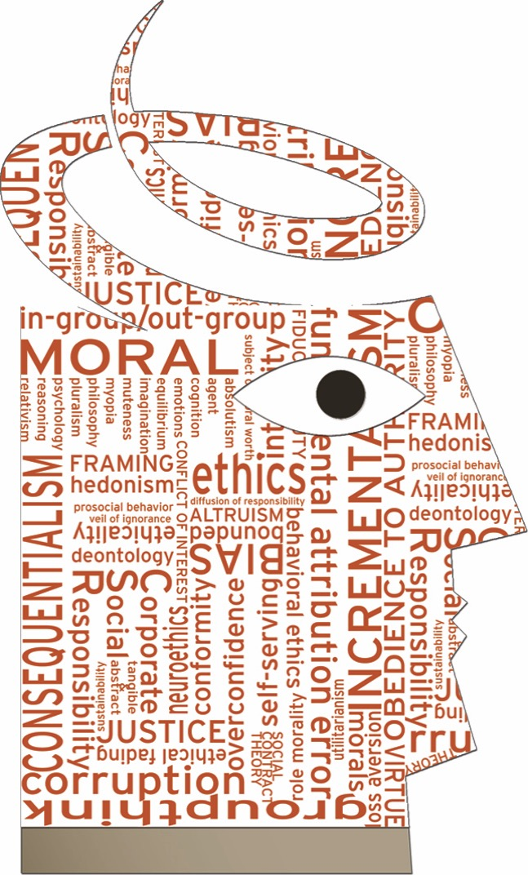
Also coming Fall 2016…
Ethics Unwrapped Video Glossary
50 ethics terms defined in
1- to 2-minute animated videos

Slide 40
Diffusion of Responsibility
In-group/Out-group

Slide 41
Questions?
www.ethicsunwrapped.utexas.edu

