Slide 1
Digital Learning, Blended Courses: The Long and Winding Road of Measuring Outcomes
Nancy Marksbury
Annie Almekinder
Enid Bryant
Laurel Hester

Slide 2
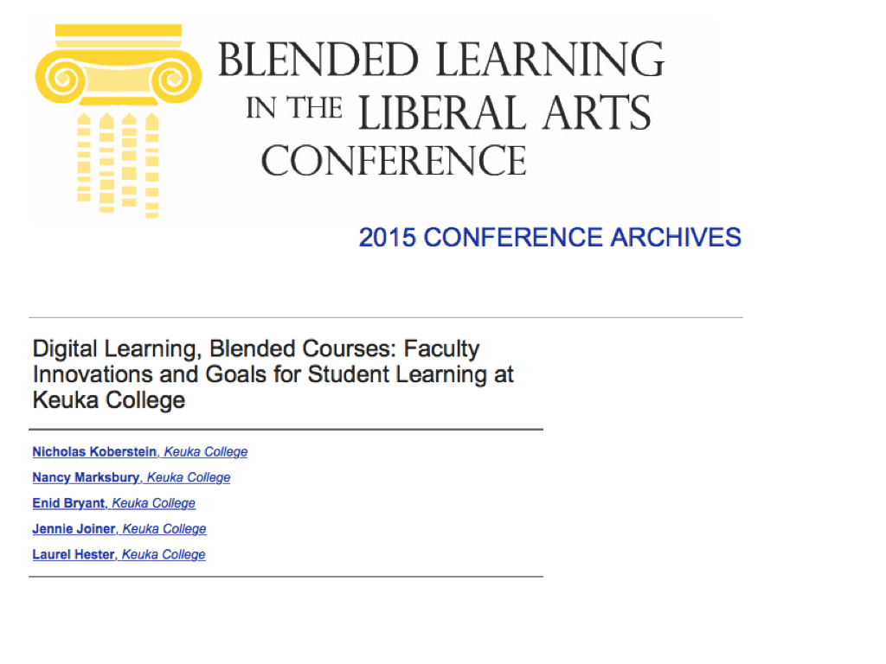

Slide 3
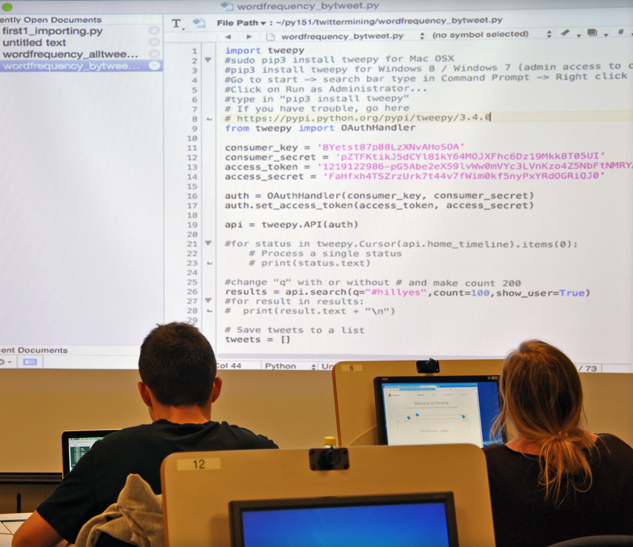
Digital Learning @Keuka College:
Creating digital thinkers who are critical thinkers
Understanding how digital tools work, their limitations and their possibilities
On campus, online and around the world

Slide 4
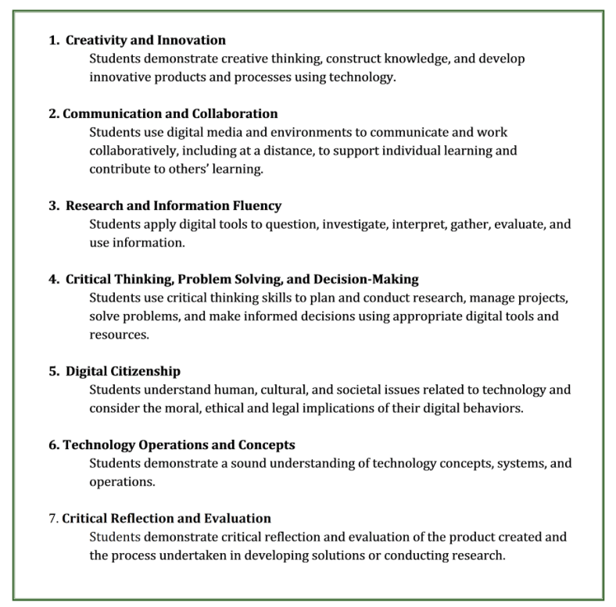
DL@KC Student Learning Outcomes v.1.0
Notes:
Where we were last year
brand new, faculty-generated DL SLOs
our charge: to refine the SLOs for measuring “digital-ness” of course content for infusing DL@KC across the curriculum
shifting from a teaching paradigm to a learning paradigm (Tag & Barr, 1995; Bass 2012)

Slide 5
A year later ...
Additive | Integrative | Elbow Grease | Outcomes
Digital Studies Minor e.Portfolio “requirement” Self-guided Information Literacy course | Digital Learning @Keuka College ad hoc faculty working group | DL Week 2015, 2016 DL Seminar Series | ~Increasing enrollment ~Growing faculty engagement
 | Technology Learning Mentors
 | Digital Action Groups

Slide 6
Digital Studies Minor
Understanding Digital Communication
Introduction to Digital Thinking
Fundamentals of Code & Digital Thinking
Digital Storytelling
Data Analytics: Big Data & Visualization
Digital Learning Capstone

Slide 7
Digital Learning @Keuka College
Notes:
Need axis label for x axis… people may be downloading this slide after the talk

Slide 8
Mapping our sample
Moodle offers a process to map all activities, assignments, and assessments to Outcomes.
DL SLOs were tracked to 10 courses in the fall 2015 and spring 2016.
Notes:
I am Director of Digital Instruction and Technology @ Keuka College. One of my roles at Keuka is to manage our LMS system, Moodle.
MAPPING OUR SAMPLE:
We decided a use the Outcomes tool in Moodle to track course activities and how we were applying the Digital Learning Student Learning Outcomes or (SLOs) in 10 courses Fall and Spring.
We began with a great conversation... What should be linked to our SLOs? Quizzes, assignments, projects, discussion articles. We focused on Learning opportunities and not student achievement. We realized that each course demands different assessment tools, projects, labs, or quizzes. We vary greatly in how we assess student learning. Some faculty are leveraging Moodle for quizzes, using the rubrics, and checklists which makes tracking very clear. Some instructors are using Moodle to provide content but are not necessarily grading within Moodle because of the nature of their content.
We decided to track 5 courses in the fall and 5 courses in the spring to determine how well we were reaching our DL SLOs within the minor and across campus.

Slide 9
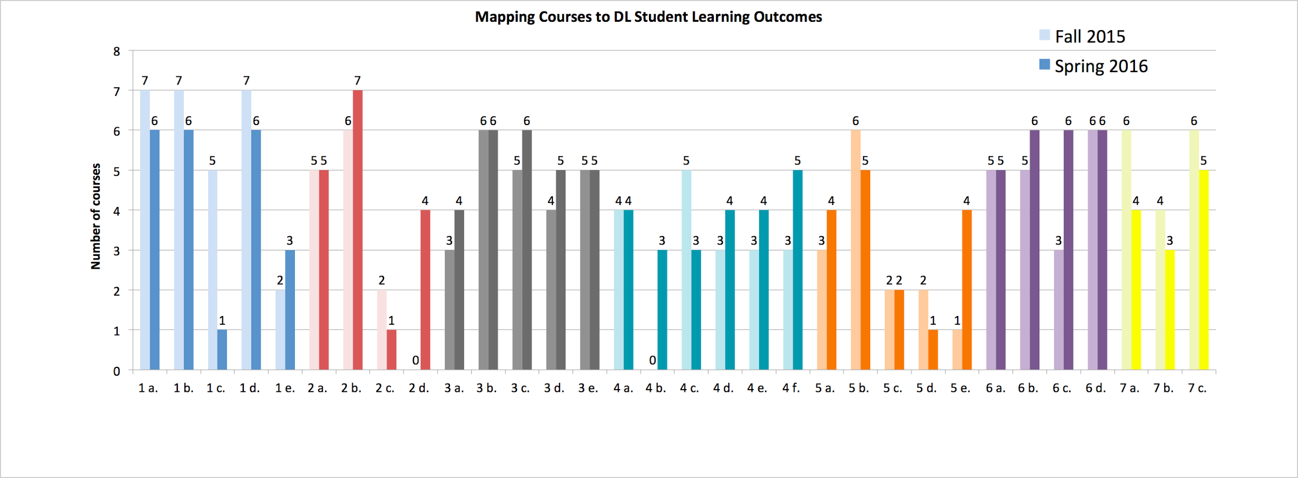
Mapping our sample
Communication and Collaboration
Digital Citizenship
Technology Operations and Concepts
Critical Reflection and Evaluation
Creativity and Innovation
Research and Information Fluency
Critical Thinking, Problem Solving, and Decision-Making
Notes:
Mapping our SAMPLE OUTCOME REPORT
Here is our first Outcome report. This graph shows the number of classes applying each SLO in activities in the fall 2015 and spring 2016.
We took the time to review our fall courses and map curriculum to the standards. This meant we went back after the course ended and tracked assignments and content to the standards.
In the Spring courses we could be more intentional in leveraging the DL outcomes. We could plan activities that reached the objectives.
We could revise our projects to include specific activities that reached our SLOs.
The activity of mapping our courses was an excellent reflection activity. We all reviewed each activity as it pertained to specific outcomes. ‘Where did ‘create a video with photos and music’ fall into these SLOs?
Using this data allowed us to see where we had deficiencies - what SLOs are not being reached yet? 4B is one that stands out. “Exhibit a positive attitude toward using Technology…” we did not have anything mapped to this in the fall, however by Spring we were able to map 3 activities. Great discussion… can we actually assess this standard? It is important to keep but not possible to easily assess. We can possibly currate results for this through reading student reflections on the course.
We found some SLOs could easily be combined for example 7 a,b,c Reflecting on oneself as a digital learner. This would add clarity in our next report.
Using the data we were able to see our strengths. Many courses offer opportunities for students to be creative and collaborate. We mapped the spring courses and could better design our course activities to reach these objectives. Instead of just completing an interview, could students record the interview, edit it, and then share it on a class wiki?
Many of the courses mapped here are offered ONLY in the Spr or Fall so we need to continue our work to map Fall to fall and spring to spring where we will see direct course growth in applying the DLSLOs.
We then reflected that this report allowed us to see how the SLOs were being reached in 10 courses. However we could not determine how deeply each activity might reach an objective.
This led us to develop a rubric to assess each activity’s mastery level.

Slide 10
Creativity and Innovation
Research and Information Fluency
Communication and Collaboration
Critical Thinking, Problem Solving, and Decision-Making

Slide 11
Digital Citizenship
Critical Reflection and Evaluation
Technology Operations and Concepts

Slide 12
Mastery Levels
Developing: Assignment/Activity was teacher directed, software specific, prescriptive | Competent: Assignment/Activity provided some directives but could be modified and enhanced by the student to include richer use of digital tool; students can choose from a selection of tools to complete the project | Exemplary: Assignment/Activity required student to develop independent process and solution, lesson was self guided, student driven product, project was open ended and provided choice, success could be demonstrated in a variety of formats
Notes:
MASTERY LEVEL _______
A group of instructors took time to map their course activities as Developing, Competent, or Exemplary.
We decided we needed to better understand how specifically we are meeting the outcomes. We took time to reflect on the mastery level of each assignment on this mastery scale. An example would be building a webpage. Many classes are doing this but with varying degrees of difficulty.
For example: a student is introduced to beginning coding through Khan Academy in DL 120. In DL 150 students will begin HTLM_ and finally by DL 390 students will build a professional website with coding. How can we identfy how our courses are building blocks that allow students to grow in their digital literacy.

Slide 13
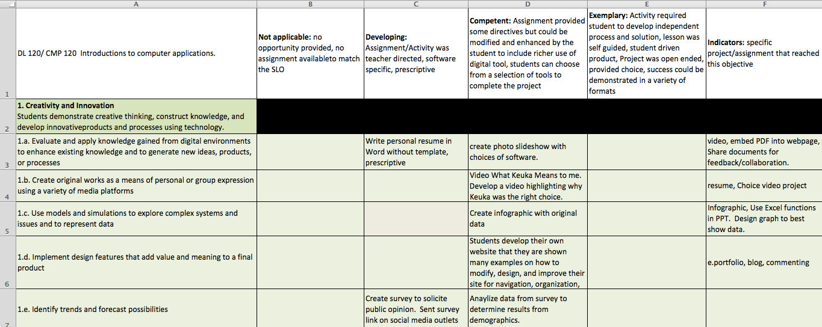
Mapping Course Activities to Mastery Levels
Notes:
MAPPING COURSE ACTIVITIES TO MASTERY LEVEL ____
Here is a snap shot of what this mapping activity presented.
We noted that we will continue to discuss level of mastery as we map courses in the future. What one of us found to be developing, another thought was more difficult.

Slide 14
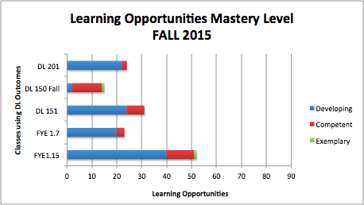
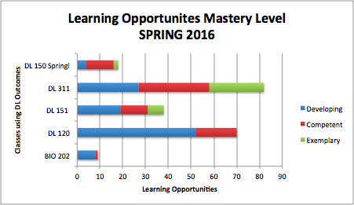
Mastery Level Frequencies
Notes:
This graph shows the mastery level of activities in the 10 courses we mapped. These charts allow us to see that our courses are intentionally building blocks to mastering the DL SLOs.
We can see that our activities are really a progression of skills in Digital Learning. It is our hope that by the time a student graduates in most courses across campus they will have been exposed to the DL skills in a variety of courses, activities, and projects.
But across campus we see this building progression also. If I teach my class how to produce a simple video in a 100 level class I will provide specific software for students to use and a required format. But as the student progresses through other courses @ the 200, 300 and 400 level classes we hope to see the student taking this skill to a higher level of competency, having choice in how the video is edited and produced for any major, or any course.
TO Note: Some courses are designed for freshmen and so those courses will always be Developing. However we hope these courses provide a foundation of digital skills that students can apply in a variety of courses across campus.
To Note: Not all courses are in the DL minor. This means that some courses were very content focused and could apply the DL Slos for only a few assignments. Laurel will discuss this further in a moment by mapping biology to the DL SLOs.
Many of the courses mapped here are offered ONLY in the Spr or Fall so we need to continue our work here to map Fall to fall and spring to spring where we will see direct course growth in applying the DLSLOs.
By applying the standards and determining the level of competency to activities as we plan the course we can be more intentional about the skills we want students to acquire. We can develop projects that encourage DL skills specifically.
Example:
One instructor on campus decided to include an infographic into the end of term research paper that will be used as the visual for the presentation - instead of a PPT. Through her intentional design, students learned to create Excel charts, work collaboratively to collect research data from credible sources, and develop a visual supporting their research paper.
Enid Bryant is going to share Digital Learning in the Humanities.

Slide 15
Mapped Assignments - Humanities
Googleography (Research and Information Fluency)
Module on Terms & Conditions & Privacy Statements (Digital Citizenship)
HTML & CSS (Critical Thinking, Problem Solving, and Decision Making)

Slide 16
Mapped Assignments - Human Biology
Moodle Topic Pages (Technology Operations & Concepts)
Study Forum Posts (Digital Citizenship)
Moodle Glossary (Technology Operations & Concepts)
Padlets (Critical Thinking, Problem Solving & Decision-Making)
Population Presentation (Research & Information Fluency)
Video Project (Creativity & Innovation/Collaboration)

Slide 17
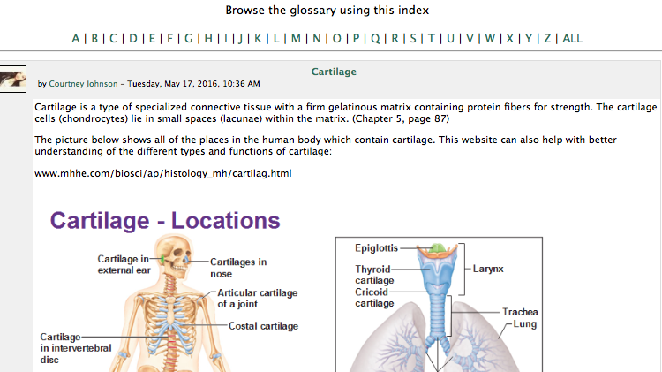
Example Glossary - Human Biology
“if you found a good website or video, please include it! For full credit remember to include chapter/page reference and a picture or link in addition to the text definition. Please make sure you ‘hyperlink’ any weblinks you add by using…”
Notes:
3 required and 9+ total opportunities to hyperlink

Slide 18
Example Padlet - Human Biology
http://tinyurl.com/ouqp2m8
Here is Marianne Jahnke’s and my Digital Learning Week Handout

Slide 19
Video Project Rubric - Human Biology
“The purpose of making this video is to communicate information about a human-biology related topic that interests you and to learn how to make a video by doing it!”
DL-related categories | Organization | Visual Appeal | Effectiveness of Delivery | Mechanics
Description of excellence | Information is very well organized with a logical flow. The purpose is clear & the narrative is compelling. | The video looks great! Props, background and/or slides seem intentional & aid content delivery | Strong/interesting delivery, tone captures audience interest | Great Eye Contact, transition between scenes, etc.
Other categories | Content Amount | Quality of Information | Creativity | References

Slide 20
Notes:
We are creating ways to stay Connected with faculty, students, Through social media.
https://digitallearningweek.wordpress.com/
https://sites.google.com/a/keuka.edu/digital-toolkit/

Slide 21
What do you think?
Notes:
In the outcomes assessment process, it is very, very easy to get hung up in the details of language – e.g., what is a standard vs. what is an outcome vs. what is a goal – have you encountered the same experiences with language and how did you resolve those issues?
Our ad hoc faculty committee has been resistant to changing the SLOs to refine some and include aspects not represented – the measurements for evaluation. Instead, some are more focused on refining the process by which courses will be evaluated. Is this a typical conflict from a group dynamic perspective?
As we each mapped our courses to the SLOs – both in Moodle and using the Excel scaled sheets – it was apparent to many that we are not addressing the reflective piece as much as we would like. Are you aware of a reflection gap in your own courses? What are your novel ideas for incorporating reflective activities in domain-specific instruction?

Slide 22
A platform to share
We are using e.Portfolios as a platform to store, share our digital work.
Field Period example
Class example
Professional example
Notes:
The portfolio has many benefits. It provides a place for students to store any work they choose in a way that is easily accessed. Students a nudged to learn the digital skills in building the web pages. They learn, page design, hyper linking, embedding of videos and other digital work.
They can then choose from a large body of work and create a final portfolio that highlights their best work.

Slide 23
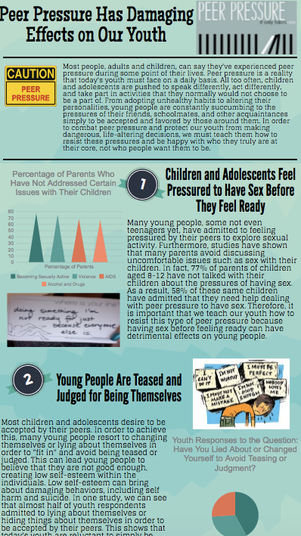
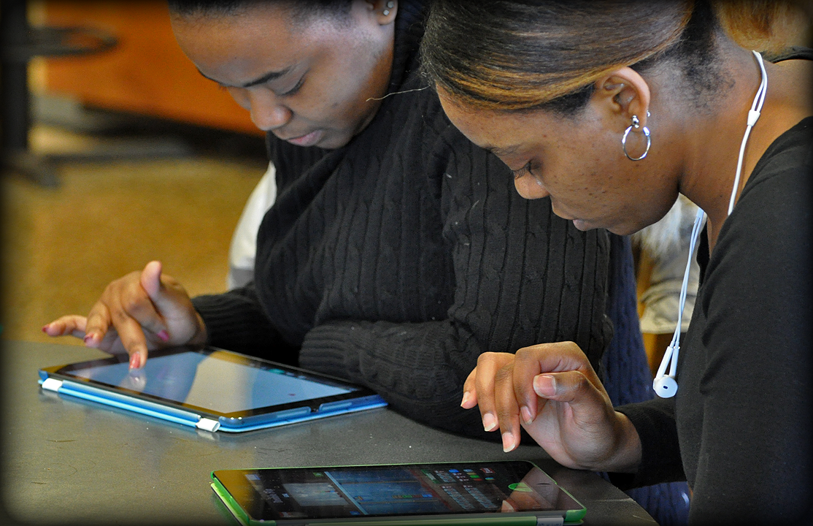
Our next steps
We want to involve more faculty in our DL SLO curriculum mapping.
We see the need to expand course learning opportunities to increase our student’s digital footprint and provide many choices to showcase work in their e.Portfolios.

Slide 24
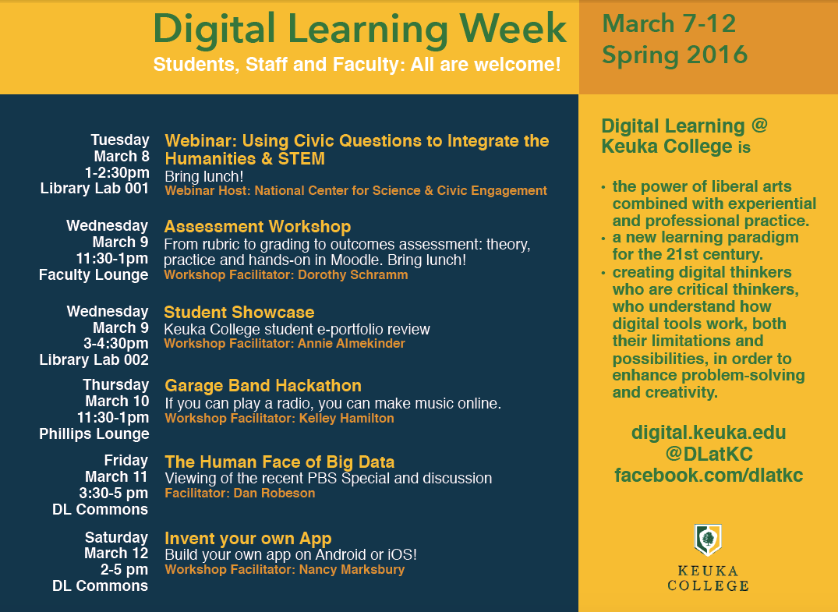
Notes:
We are working to include more faculty in this initiative:
Each semester we host Digital Learning Week; This is a time where faculty can share their successes, learn from each other, and get inspired to try something new.

Slide 25
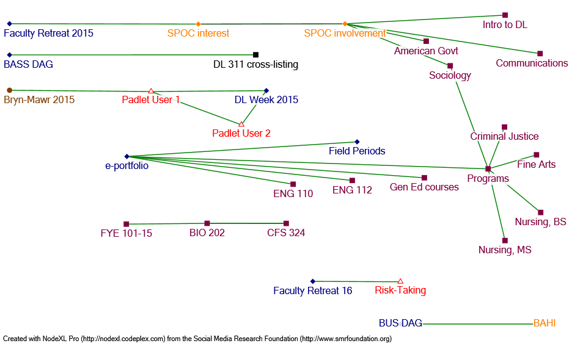
Digital Learning Proliferation

Slide 26
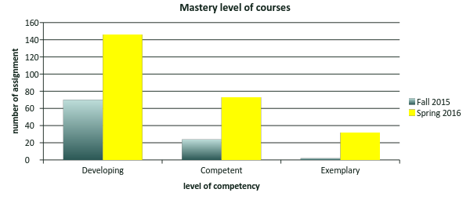
Level of mastery in assignments, projects, and activities.
9 courses included in this graph

Slide 27
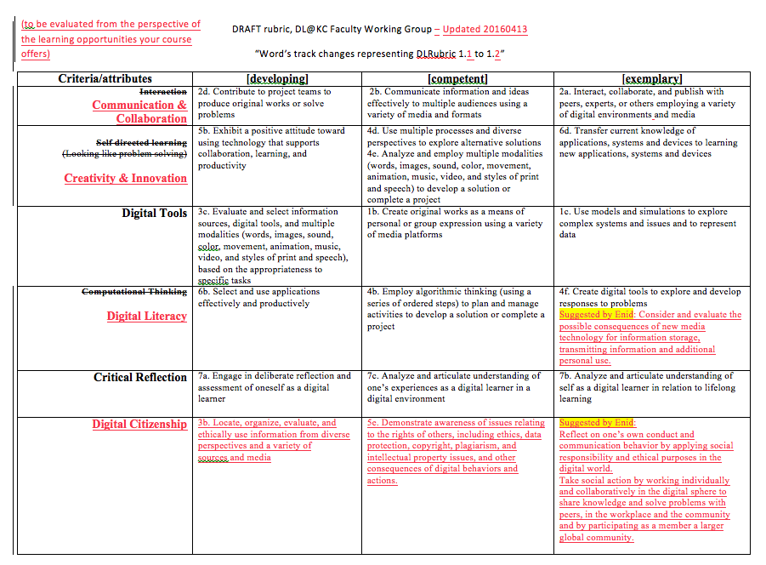

Slide 28
Keuka College’s institutional vision is to become a leader within higher education in integrating digital learning into the liberal arts. Our Digital Learning at Keuka College (DL@KC) initiative aims to encourage students to think critically about how digital tools and technologies work and the possibilities and limitations of their use in enhancing problem solving and creativity. The initiative was introduced at last year’s conference in presenting examples of faculty experimentation and a preliminary set of student learning outcomes, generated by faculty, was shared.
Our journey continues by reflecting on student performance in courses designed with these embedded student outcomes, our methods for evaluating our progress, and what we learned about our students, our courses, and assessments.
In this session, we report our preliminary findings and three aspects of our process. One, we address the technical challenges of automating the process of scoring student progress within Moodle, configuring a scale for skill progression, and factoring in course activities that occur outside of the course management system. Two, we report on the complex activity of aligning indicators across content areas in both required and elective courses, uncovering areas of ambiguity and reaching across disciplines to find commonalities in technology-infused instruction. Third, we detail second order effects of the process of benchmarking our progress, discovering the areas we found that remain unaddressed in individual courses and across programs, and how our work cycles back to inform rubric generation to facilitate outcome assessment and adoption across the curriculum.
Digital Learning, Blended Courses: The Long and Winding Road of Measuring Outcomes
Nancy Marksbury, Annie Almekinder, Laurel Hester, Nicholas Koberstein, Douglas Richards
Keuka College

