Slide 1
Increasing student engagement with course media
Ananda Gunawardena
Princeton University / CMU
Bryn-Mawr Blended Learning Conference
2016

Slide 2
Getting Started
Go to http://classroomsalon.net
Sign up for an account using code “princeton”
Go to Recommended Salons and Join the “Bryn-Mawr Blended Learning” salon
Complete the Bio and answer 3 questions and fill out the pre-conference survey form

Slide 3
Workshop Goals
Develop a good model of content engagement
Work together to improve the model for blended learning
Be part of a team of educators looking to develop and extend tools that are highly effective

Slide 4
Workshop Structure
Demonstration of my own class
Importing media
Setting up media
prompts
To Do List
Interactive mode
videos
Data driven instructions
Building of your own experimental salon
Build a new salon
Define salon objective
Reading salon, comprehension salon
Import media
Set up media
Deploy and collect data
Measure, refine and repeat

Slide 5
Content Engagement
Define student engagement with content
How do students engage with content-based courses?
How do they seek answers to their conceptual questions?
How do we increase the opportunities for content engagement and measure it?
Develop strategies to increase student engagement with content
passive to active
Undetected to detected

Slide 6
Content Engagement Life Cycle
Prepare/update content
Embed engagement prompts
Set minimum requirements of engagement instructor prompts
Access analytics
Provide feedback
Refine teaching

Slide 7
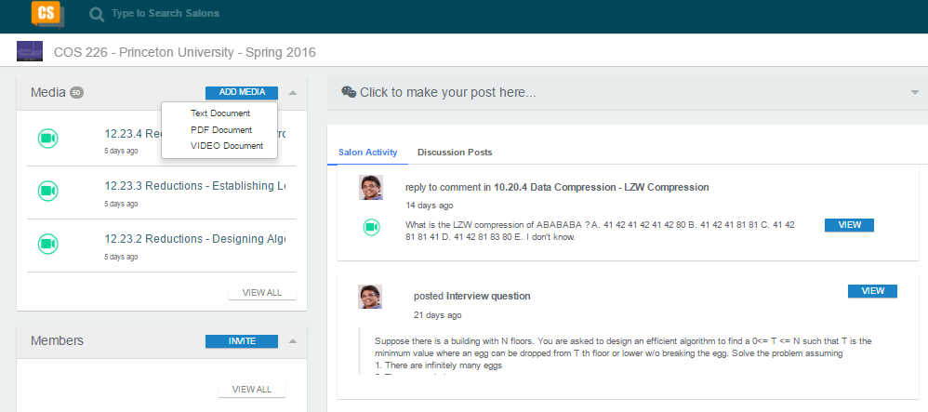
Prepare/Update Content

Slide 8
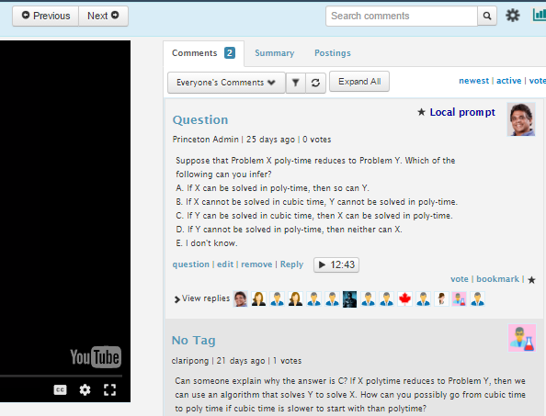
Embed Engagement Prompts
Engagement prompts are specific to a content location

Slide 9
Minimum Requirements for engagement
To demonstrate engagement
you must respond to all prompts
ask questions, anonymously if you’d like. But keep it in the context
Reply to a question/discussion post by another student
Be consistent
Clearly state how you are going to provide them with an engagement score
Some weighted formula with responses, questions, replies, and consistency, time spent with media etc

Slide 10
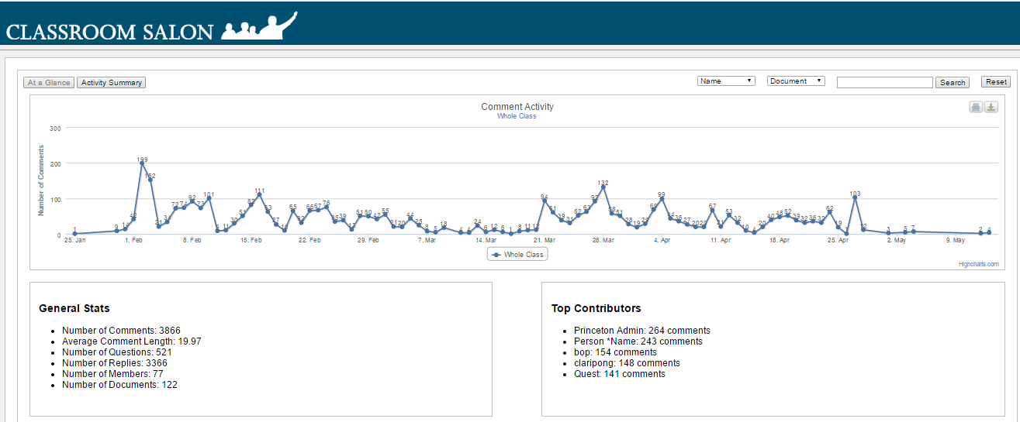
Access Analytics

Slide 11
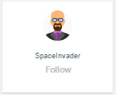
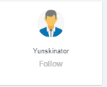
Provide feedback
Message: You have not been engaged for a while. Please work on assignments
Message: Great Job!!! Happy to see all the work you are putting in

Slide 12
Refine Teaching
Find out the “hotspots” of interactions
Video hotspots (comments, access)
Document hotspots (comments, access)
Filter by specific tags
I want to know more, I find this difficult, this is important
Make a plan to address
What students “want” to know
Not what the teacher “wants” to teach

Slide 13
What I know so far
Student engagement
vary from student to student
Vary during certain time intervals
Can be guided by prompt based learning techniques
Can be increased by continuous feedback on how they are doing
Can be rewarded to create more positive impact

Slide 14
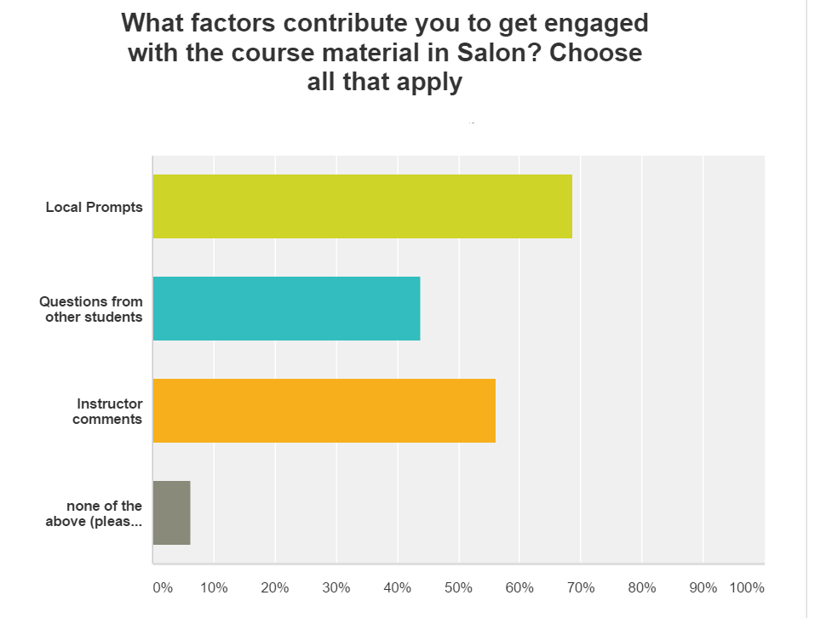

Slide 15
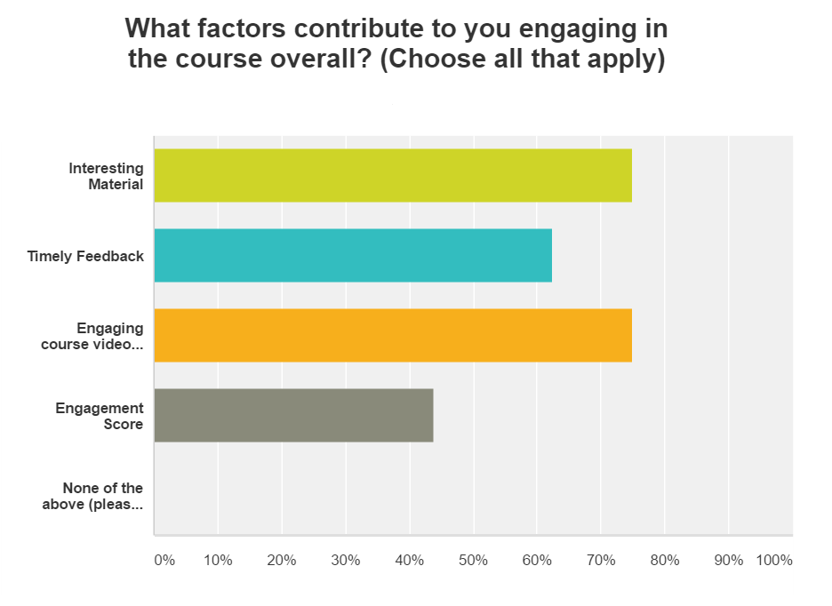

Slide 16
Demonstration
The nature of the course
Computer Algorithms
Popular course at Princeton (many majors see the course as a gateway to lucrative jobs in Wall Street)
Enrollments have been increasing
260 students in Spring 2016
Diversity of students have been increasing
Challenge: How to improve the course with the same amount of resources

Slide 17
Google sees a need to get students engaged with course content with analytics driving teaching and learning

Slide 18
What Data Tells us
Teach students “how to learn”
Defining and measuring student engagement
Types of engagement
academic, cognitive, intellectual, institutional, emotional, behavioral, social, and psychological

Slide 19
Easy Steps to get started
Sign up for a salon account
http://classroomsalon.net (code: princeton)
Create a learning unit that requires close interactions with documents and videos
Create a salon to test the learning unit
Upload the documents/videos to support the learning objectives
Embed discussion or comprehension prompts
Deploy and refine the model.
Questions? Send email to classroom-salon@andrew.cmu.edu or search for the “training” salon and become a member

